Slide 1



KONGU ENGINEERING COLLEGE
PERUNDURAI ERODE-638060
DEPARTMENT OF CT-PG
PHOTOGRAPHY EVENT MANAGEMENT SYSTEM
Team Members:
Nandhini V (22ISR029)
Balachandran K K (22ISR005)
Lalithambigai S (22ISR021)
Team Guide :
Dr.T.Maragatham
Associate Professor
Department of CT-PG
Consultant:
Snappy Boys Photography

Slide 2

Objective
To streamline photography event management for both users and administrators.
To provide a user-friendly platform for booking, customizing packages, and ordering prints/merchandise.
To enable camera renting and photo contest submissions.

Slide 3
Existing System
Manual booking processes prone to errors.
Limited or no customization options for photography packages.
Lack of streamlined workflows for managing events, orders, or contests.
Inefficient management of camera rentals and merchandise orders.
DISADVANTAGES:
Higher Risk of Human Error
Disorganized Operations
Resource Mismanagement

Slide 4
Proposed System
A web-based platform with separate User and Admin panels.
Intuitive modules for portfolio galleries, testimonials, and service booking.
Streamlined workflows for administrators to manage bookings, contests, and orders.
Integrated options for renting cameras and ordering prints/merchandise. ADVANTAGES:
User-Friendly Experience
Customization and Flexibility
Enhanced Event Coordination
Improved Equipment Utilization

Slide 5
Modules
The modules used in our project are
  User Management
  Admin Management
  Custom Package Management
  Event Scheduler Management
  Equipment Rental Management

Slide 6
Module Description
1)User Management:
              Handles user registration, login, and profile management.
Manages notifications and user details for seamless interaction.
Sub Modules:
          User Registration and Login
User Profile Management
Notification Management

Slide 7
2) Admin Management:
              Admin authentication and user account management.
              Admin oversees booking, testimonials, and contest approvals.
              Users can make bookings, submit testimonials, and participate in contests.
              Admin ensures system integrity by monitoring user activities.
Sub Modules:
Event Management
Booking Approval
Booking Management
Testimonial Approval
Contest Management

Slide 8
3) Custom Package Management :
              Users can either create their own custom package or choose from ready-made package templates.
              After selecting or creating a package, users can review all the package details before finalizing.
Sub Modules:
Package Builder
Predefined Package Templates
Add-On Services
Package Summary

Slide 9
4) Event Scheduler Management:
              Users can either create their own custom package or choose from Users can view available slots through a calendar interface, manage their bookings, and avoid double booking conflicts.
              Users can confirm bookings, and if needed, reschedule or cancel them, with all event details accessible throughout the process.
Sub Modules:
Calendar Interface
Slot Management
Double-Booking Prevention
Booking Confirmation
Rescheduling & Cancellation

Slide 10
5) Equipment Rental Management
              Users can browse equipment listings, check availability, and book rentals based on product details.
              After booking, users can manage their rentals, including tracking, modifying, or canceling, with access to product details.
Sub Modules:
Equipment Listing
Availability Check
Rental Booking
Return Management

Slide 11
Technologies Used
Frontend: HTML, CSS, JavaScript, Bootstrap
Backend: PHP
Database: MySQL
Server: Apache (XAMPP)

Slide 12
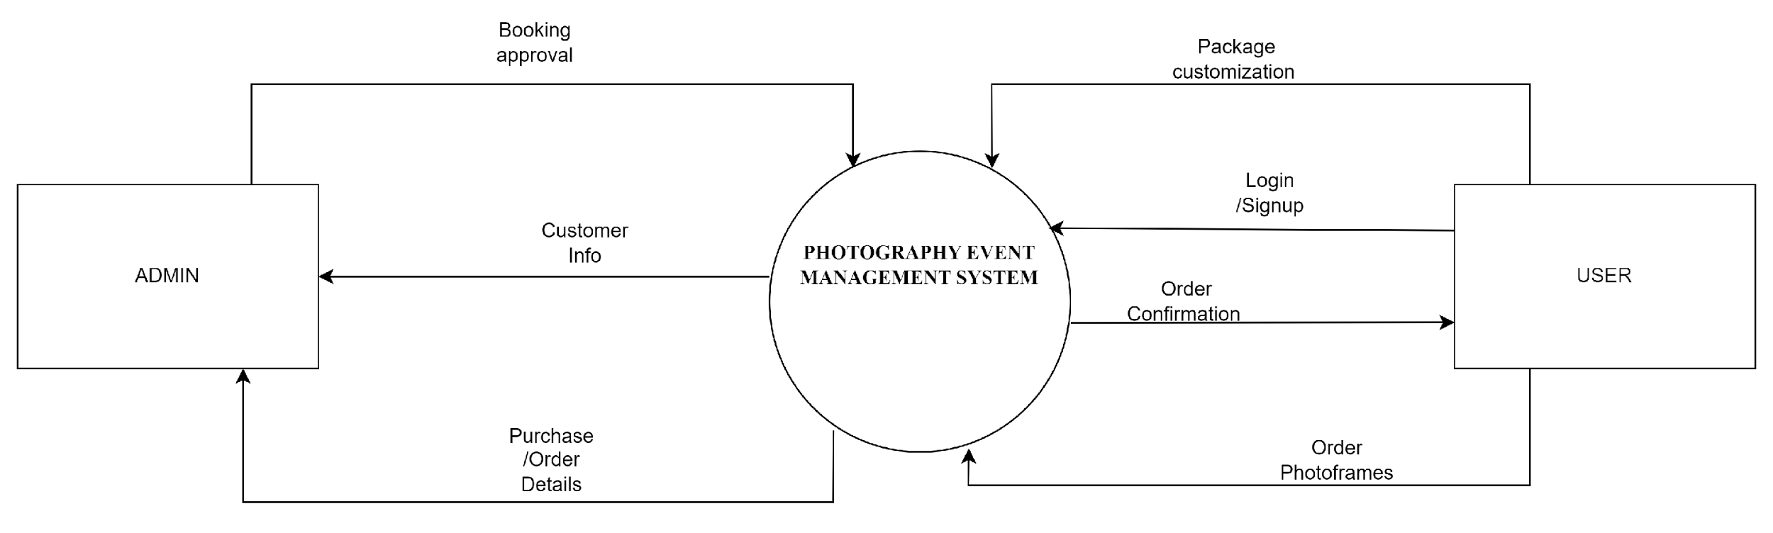
Data flow diagram for level 0

Slide 13
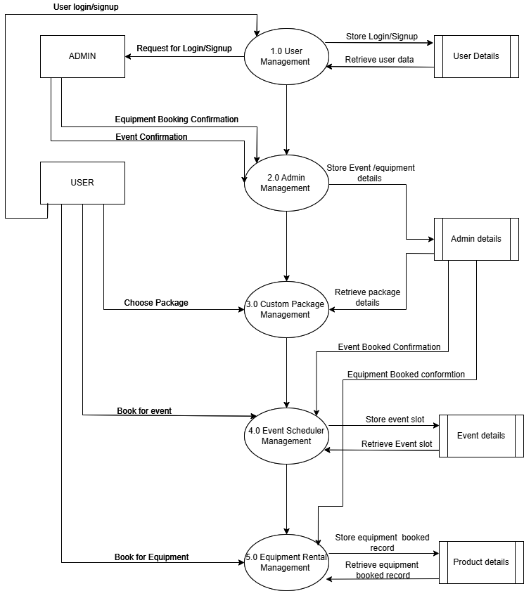
Data flow diagram for level 1

Slide 14
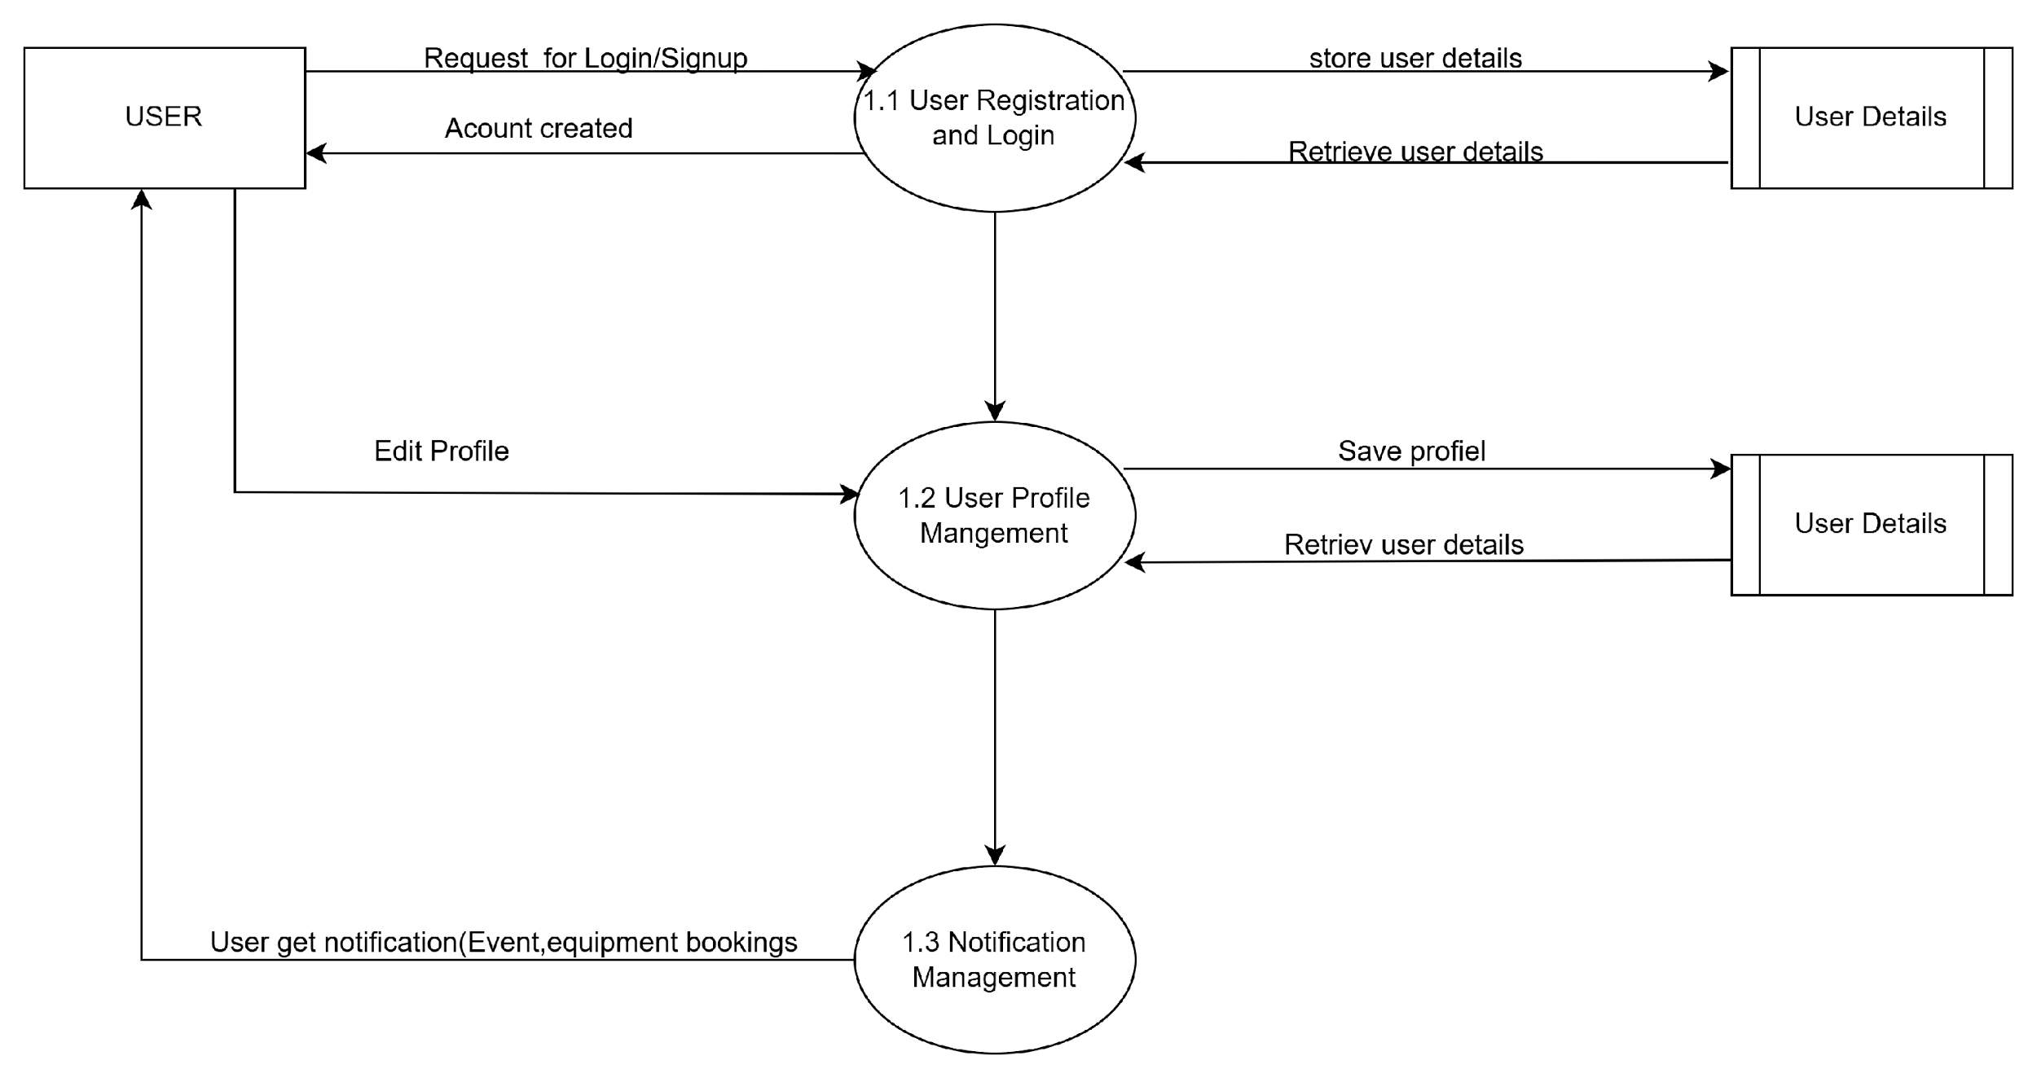
DFD Level 2(User Management )

Slide 15
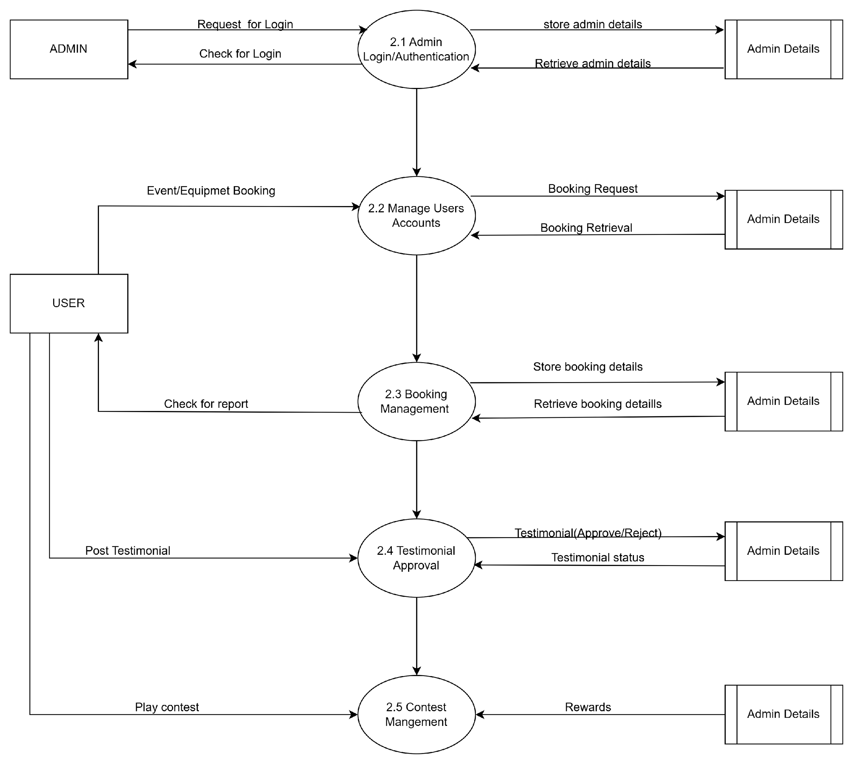
DFD Level 2(Admin Management )

Slide 16
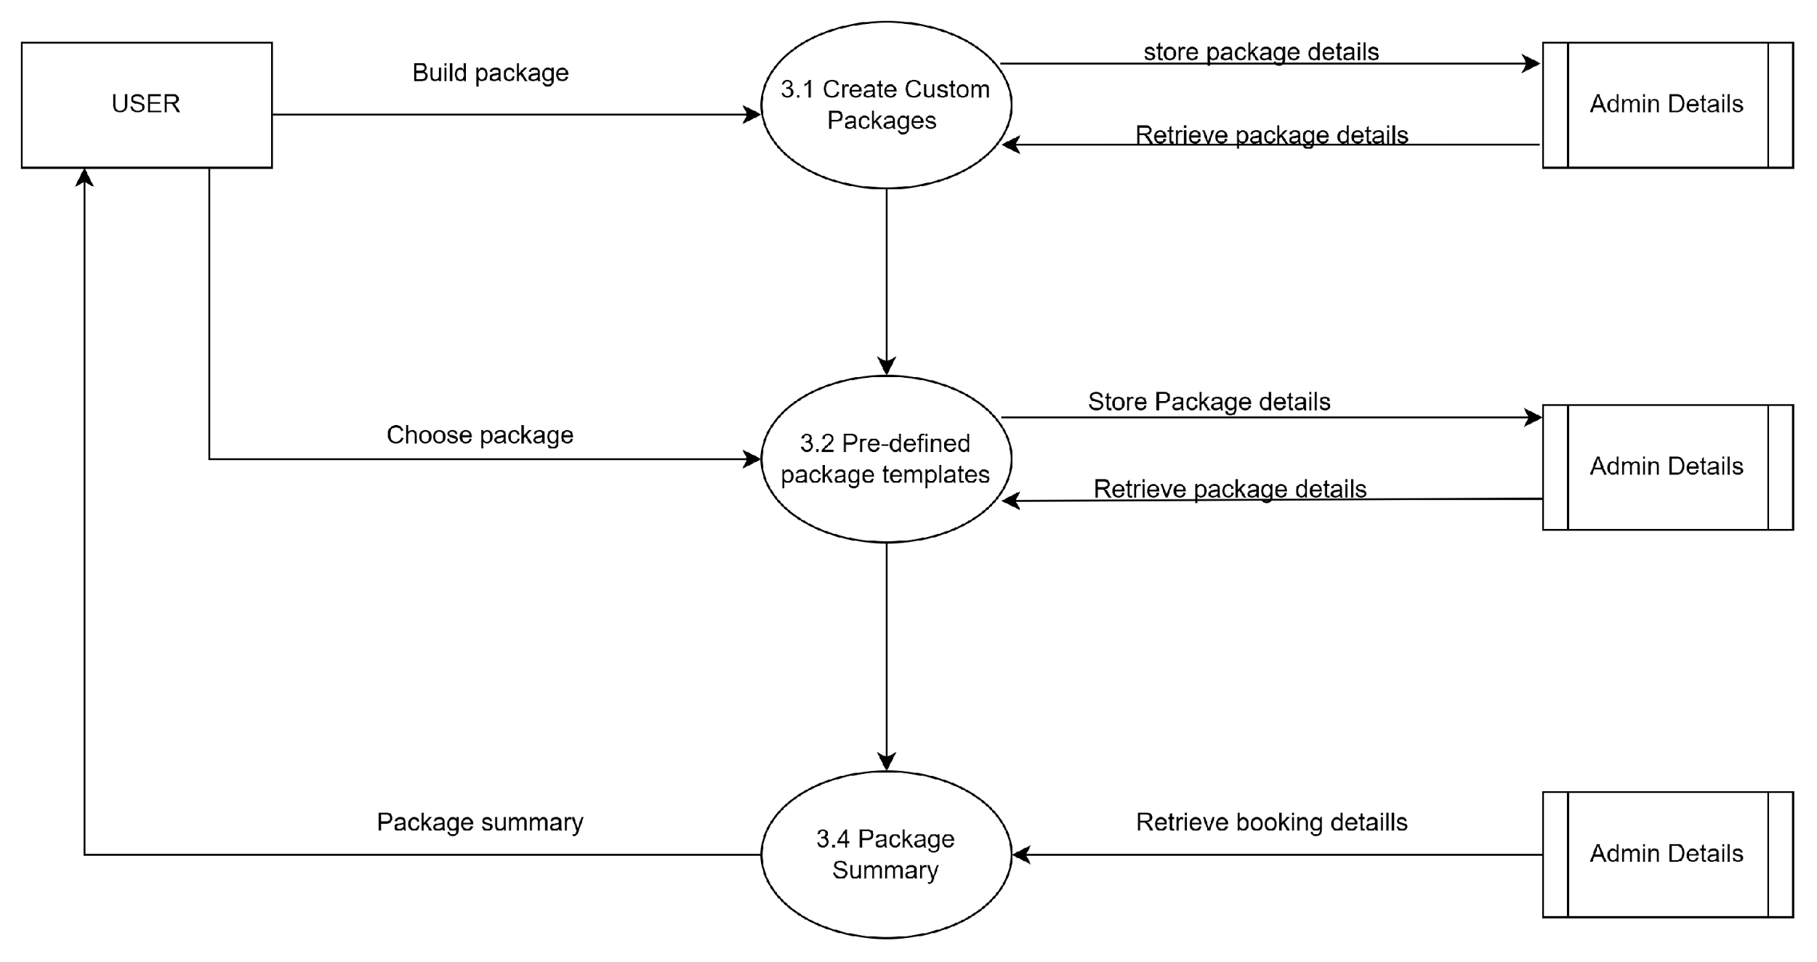
DFD Level 2(Custom Package Management)

Slide 17
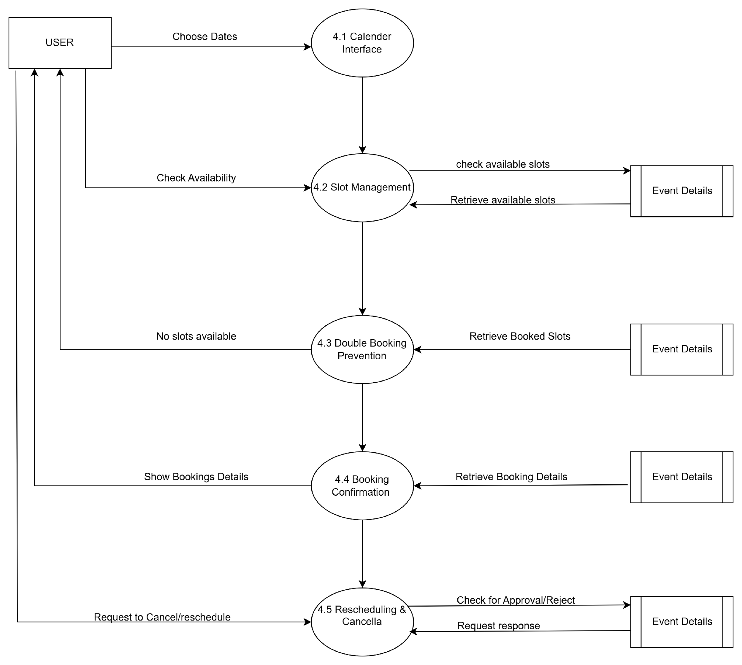
DFD Level 2(Event Scheduler Management)

Slide 18
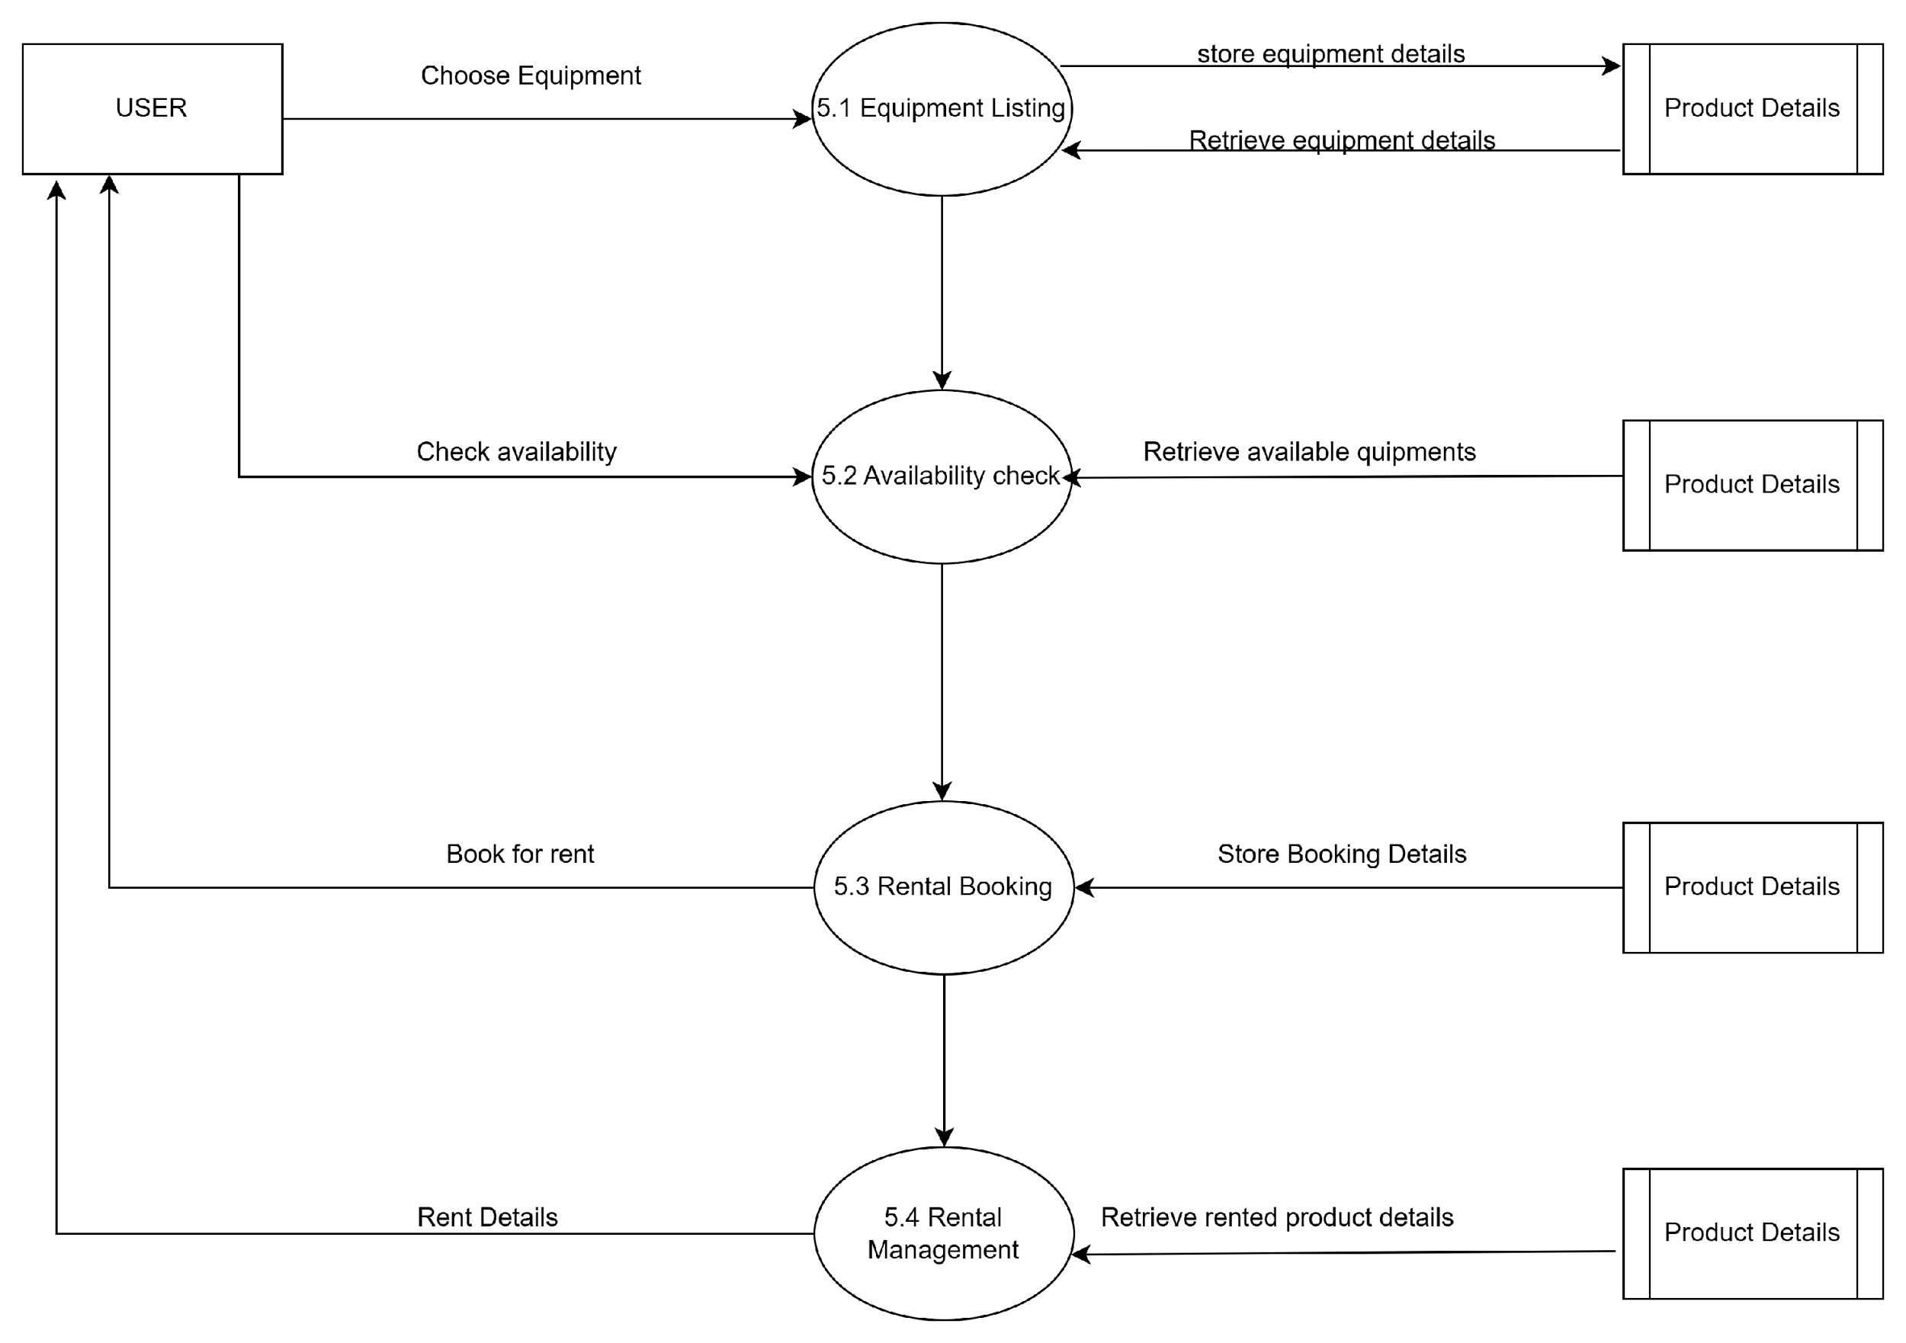
DFD Level 2(Equipment Rental Management)

Slide 19
Tables
User Details
Admin Details
Product Details
Event Details
Product Booking Details
Event Booking Details

Slide 20
USER TABLE
FIELD NAME | DATA TYPE | SIZE | CONSTRAINTS
user_id | INTEGER | 5 | PRIMARY KEY
full_name | VARCHAR | 20 | NOT NULL
email_id | VARCHAR | 30 | NOT NULL
password | VARCHAR | 8 | NOT NULL
contact_no | NUMBER | 10 | NOT NULL
dob | DATE | - | NOT NULL
address | VARCHAR | 200 | NOT NULL
city | VARCHAR | 50 | NOT NULL
country | VARCHAR | 30 | NOT NULL

Slide 21
ADMIN TABLE
FIELD NAME | DATA TYPE | SIZE | CONSTRAINTS
admin_id | INTEGER | 5 | PRIMARY KEY
admin_name | VARCHAR | 20 | NOT NULL
password | VARCHAR | 8 | NOT NULL

Slide 22
EVENT TABLE
FIELD NAME | DATA TYPE | SIZE | CONSTRAINTS
event_id | INTEGER | 5 | PRIMARY KEY
event_name | VARCHAR | 20 | NOT NULL
base_price | DECIMAL | (10,2) | NOT NULL

Slide 23
PRODUCT TABLE
FIELD NAME | DATA TYPE | SIZE | CONSTRAINTS
product_id | INTEGER | 5 | PRIMARY KEY
camera_model | VARCHAR | 50 | NOT NULL
camera_brand | VARCHAR | 15 | NOT NULL
camera_overview | VARCHAR2 | 250 | NOT NULL
price_per_day | INTEGER | 11 | NOT NULL
lens_type | VARCHAR | 20 | NOT NULL
model_year | VARCHAR | 6 | NOT NULL
resolution | INTEGER | 11 | NOT NULL
c_image1 | BLOB | - | NOT NULL
c_image2 | BLOB | - | -
c_image3 | BLOB | - | -
c_image4 | BLOB | - | -
c_image5 | BLOB | - | -
accessories | VARCHAR | 100 | NOT NULL

Slide 24
PRODUCT BOOKING TABLE
FIELD NAME | DATA TYPE | SIZE | CONSTRAINTS
product_booking_id | INTEGER | 5 | PRIMARY KEY
user_id | INTEGER | 5 | FOREIGN KEY
product_id | INTEGER | 5 | FOREIGN KEY
booking_number | INTEGER | 12 | NOT NULL
email_id | VARCHAR | 30 | FOREIGN KEY
from_date | DATE | - | NOT NULL
to_date | DATE | - | NOT NULL
status | VARCHAR | 10 | NOT NULL

Slide 25
EVENT BOOKING TABLE
FIELD NAME | DATA TYPE | SIZE | CONSTRAINTS
event_booking_id | INTEGER | 5 | PRIMARY KEY
user_id | INTEGER | 5 | FOREIGN KEY
event_id | INTEGER | 5 | FOREIGN KEY
event_name | VARCHAR | 20 | FOREIGN KEY
email_id | VARCHAR | 30 | FOREIGN KEY
date_range | TEXT | - | NOT NULL
slot_details | VARCHAR | 30 | NOT NULL
total_price | DECIMAL | (10,2) | NOT NULL
reference_image | BLOB | - | NOT NULL
booking_date | DATE | - | NOT NULL
status | VARCHAR | 10 | -

Slide 26
Future Enhancements
Online Payment Gateway
– Add secure payment options for bookings
and rentals.
– Enable instant confirmation of transactions.
Mobile App Integration
– Develop mobile apps for on-the-go access.
– Improve real-time notifications and usability.

Slide 27
Conclusion:
Offers a user-friendly, web-based solution for managing photography events, bookings, and rentals.
Enhances efficiency by automating workflows for users and administrators.

Slide 28
USER PANEL SCREENSHOTS

Slide 29
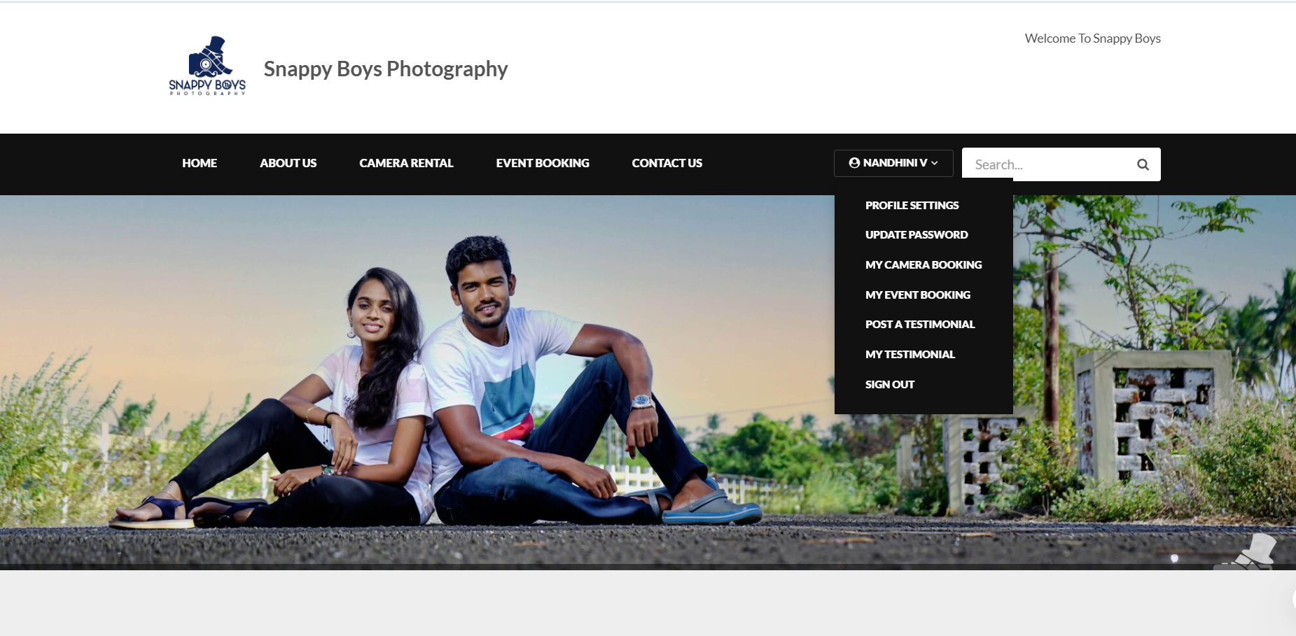
Screenshots:

Slide 30
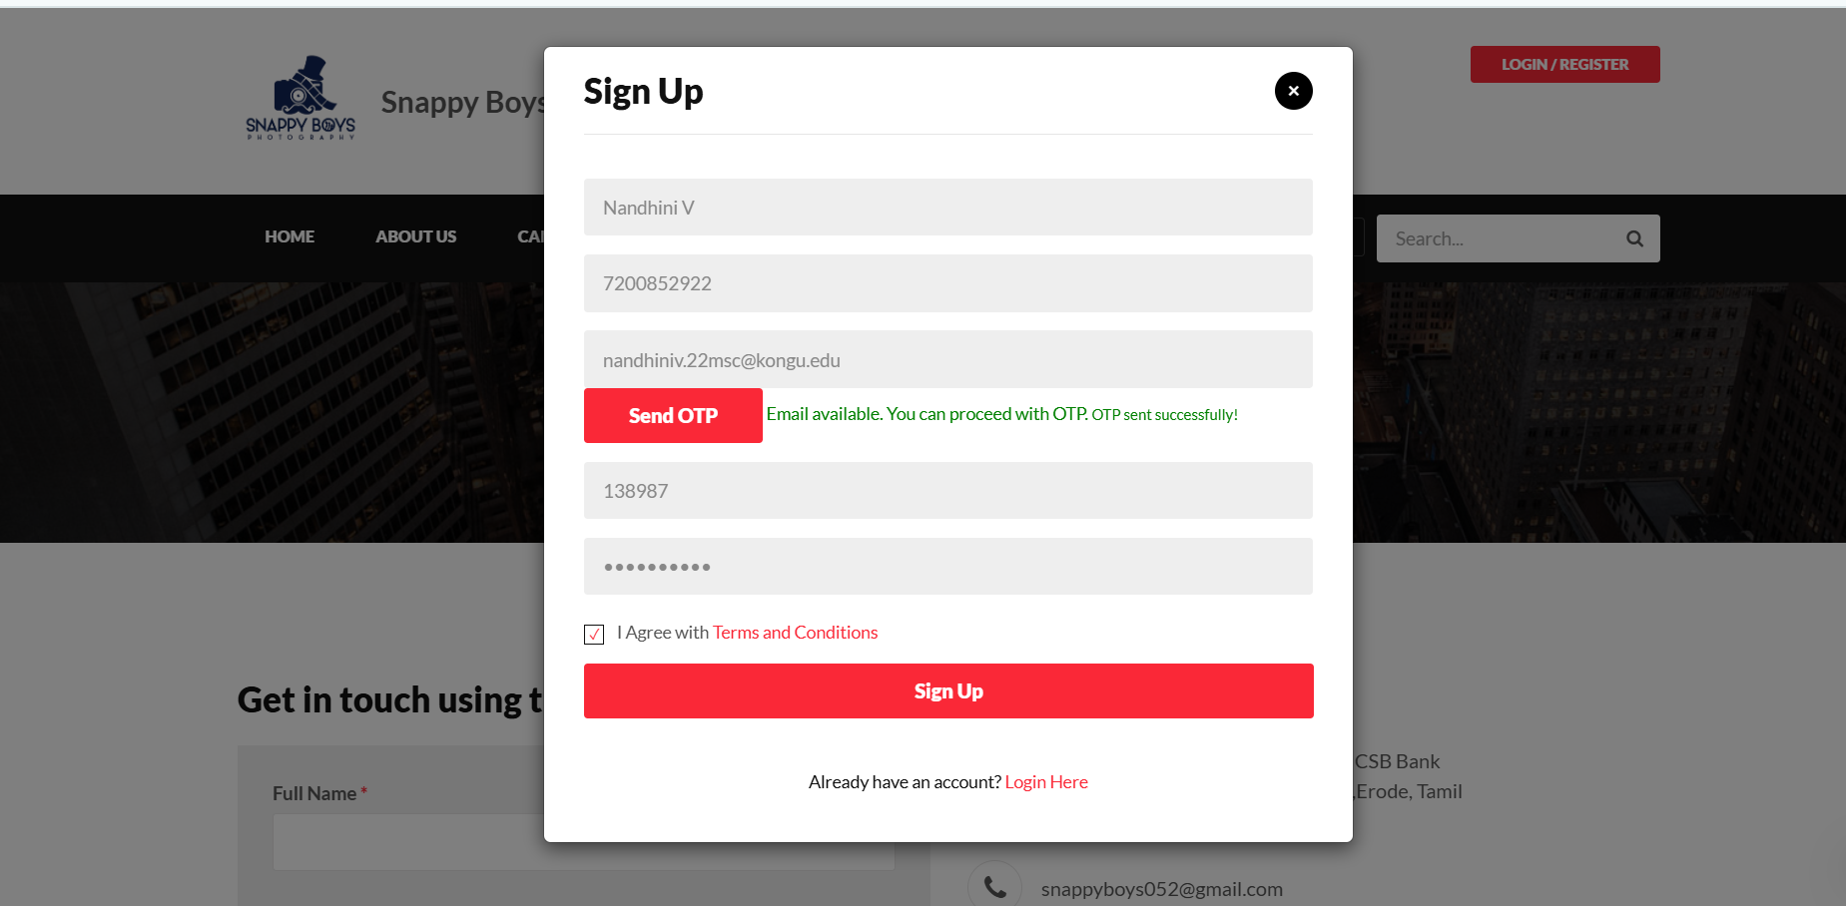
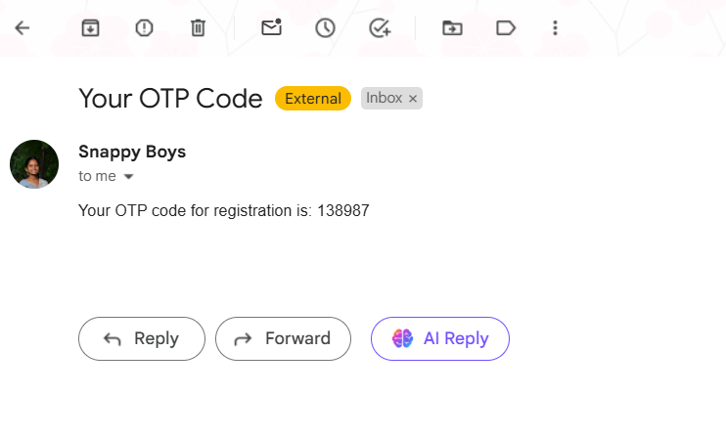

Slide 31
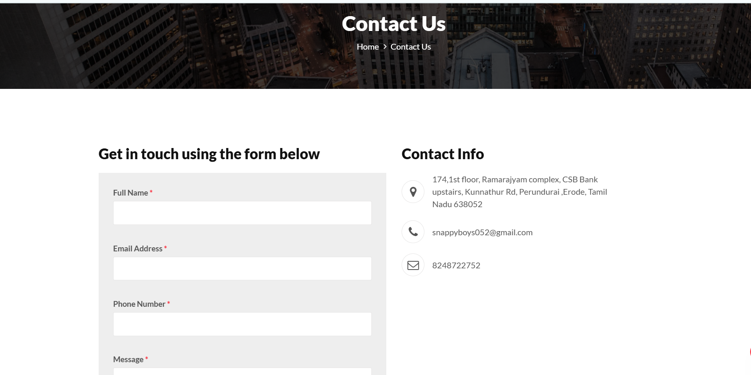
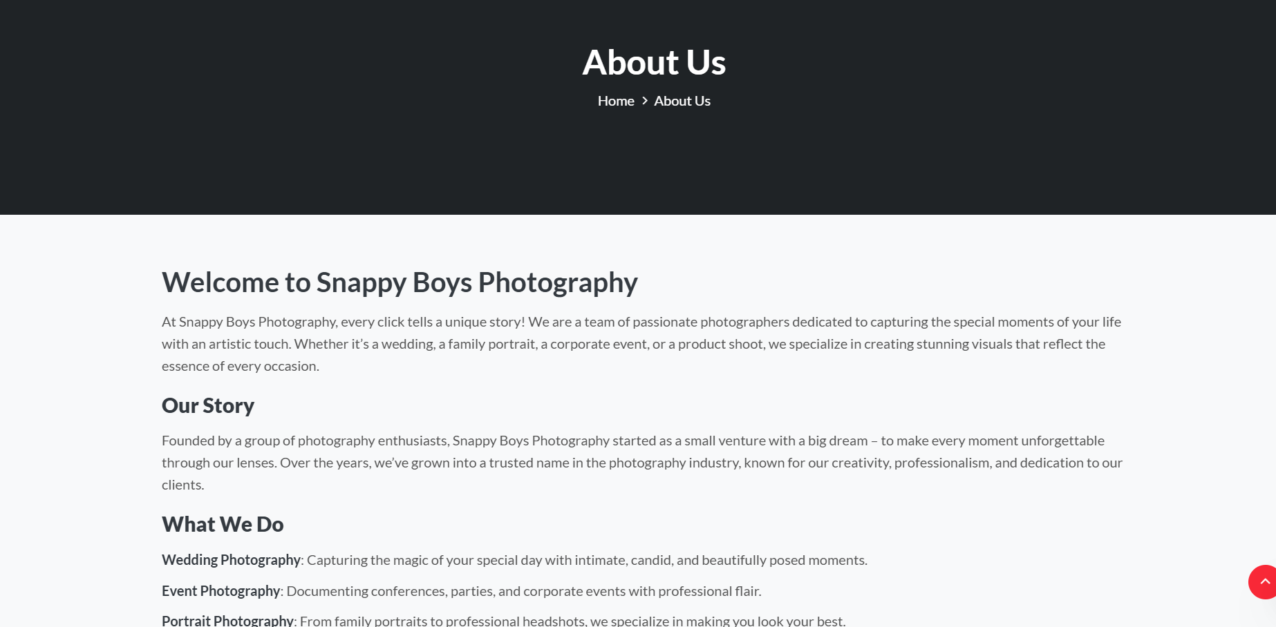

Slide 32
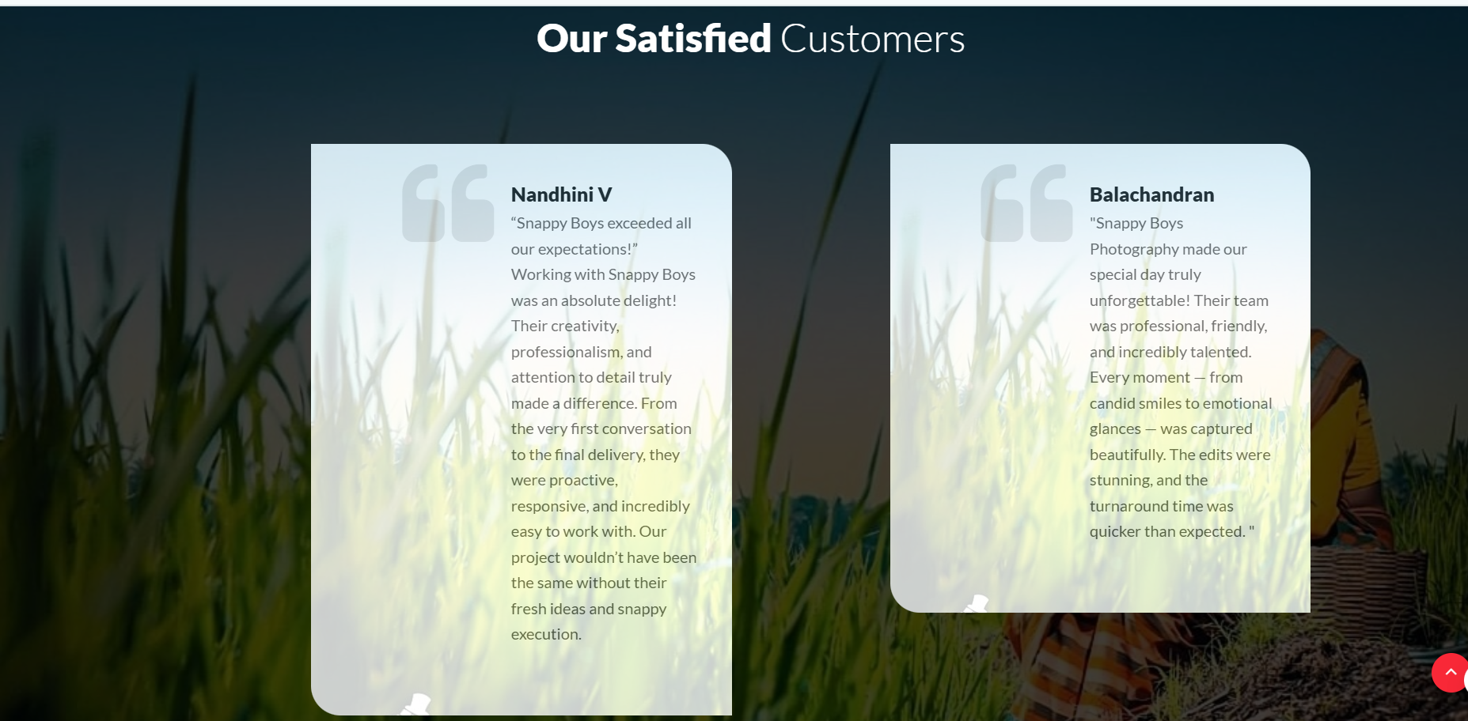

Slide 33
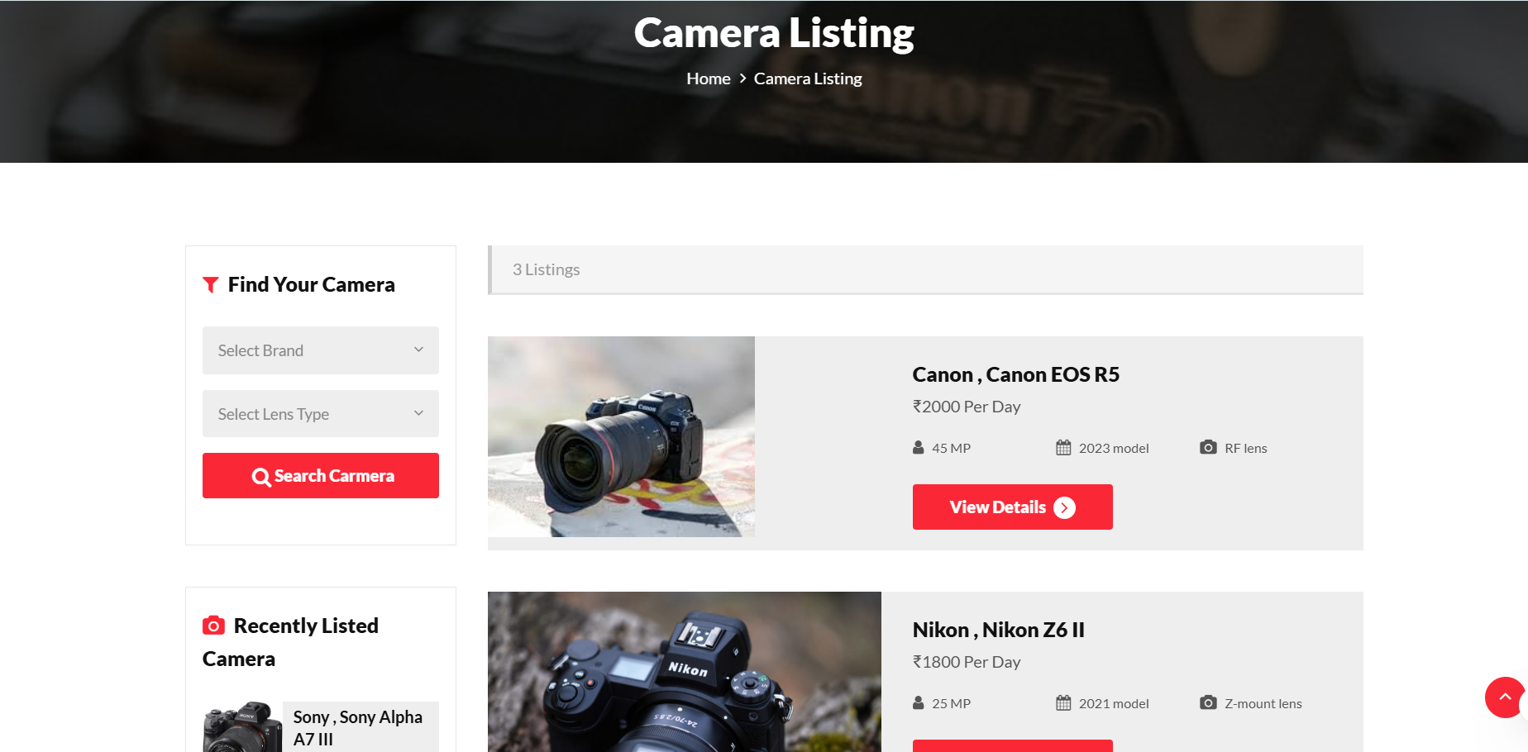

Slide 34
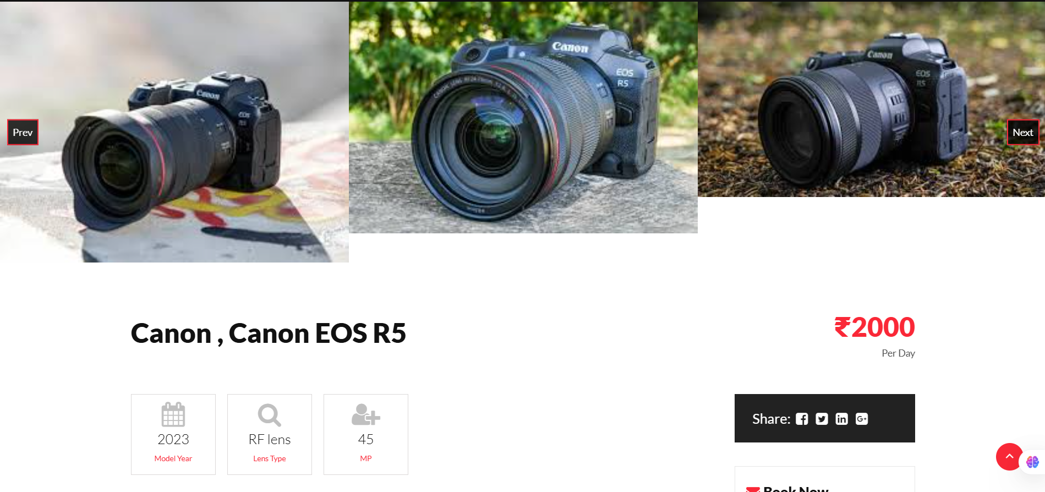
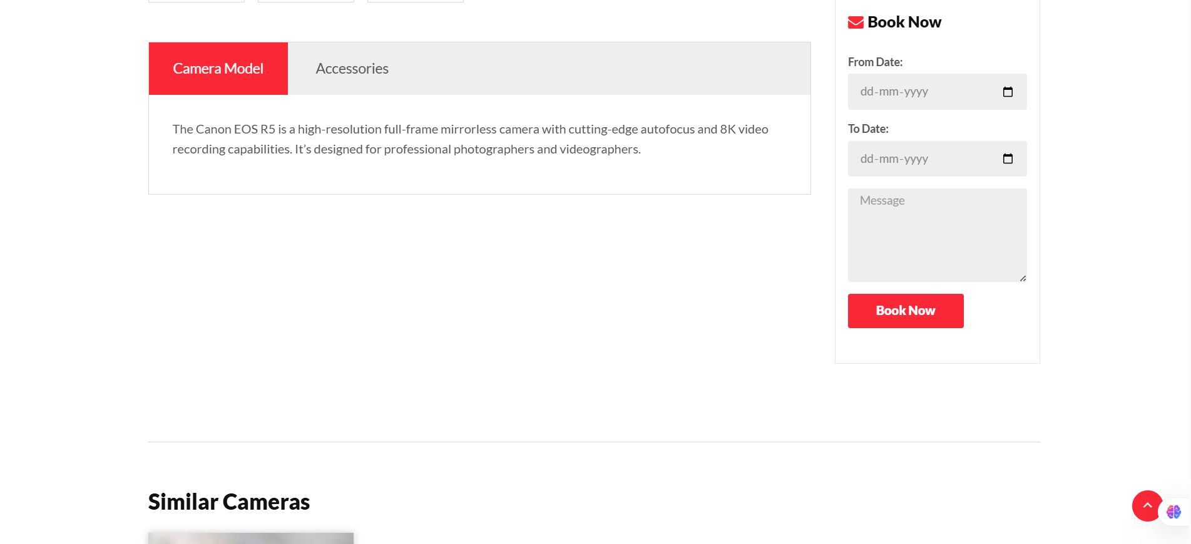

Slide 35
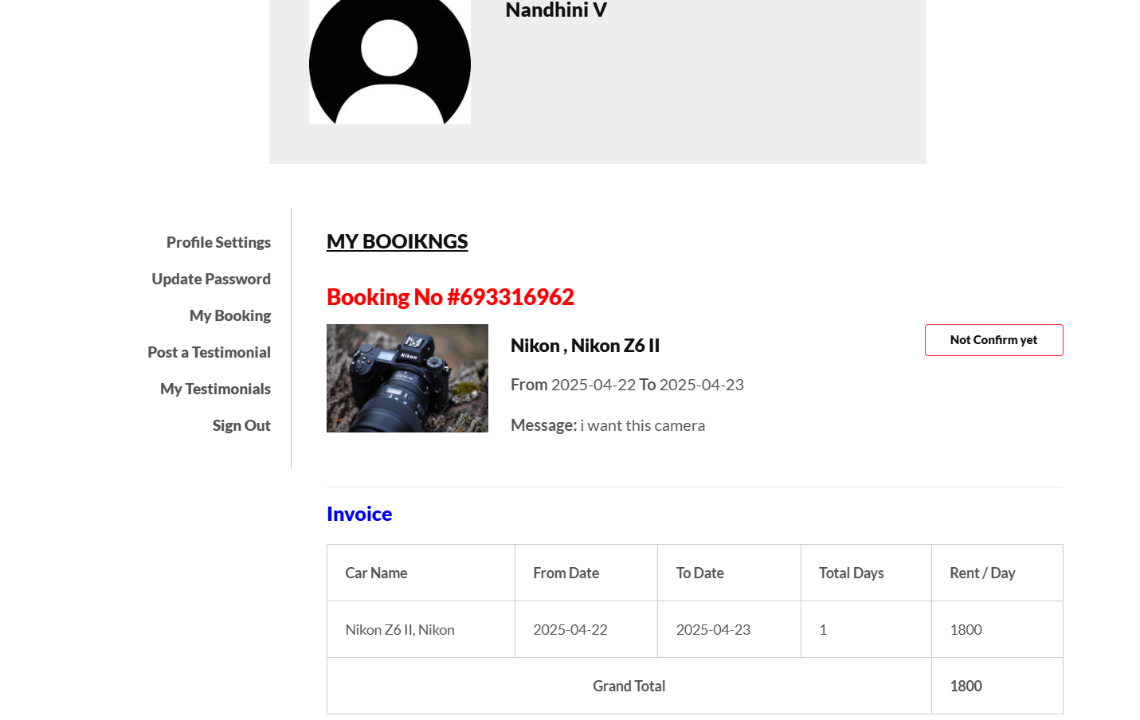

Slide 36
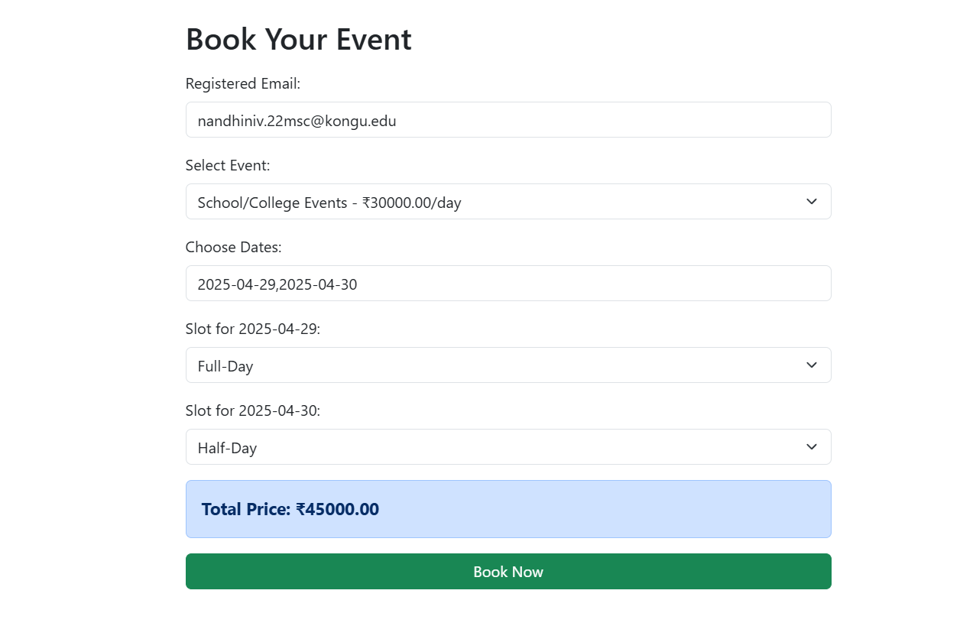

Slide 37
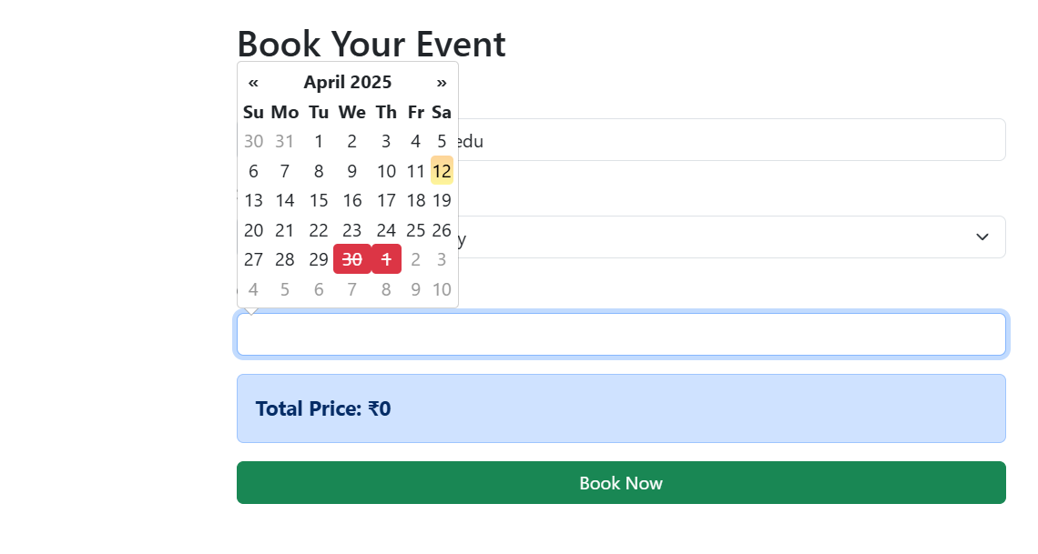

Slide 38
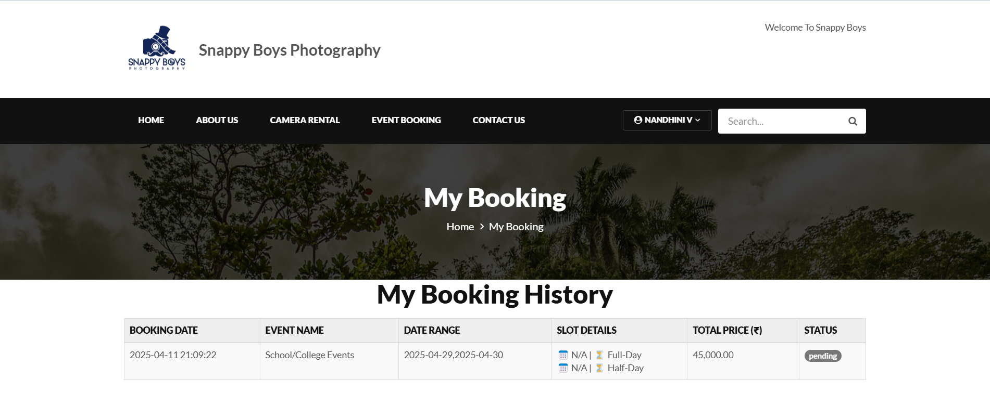

Slide 39
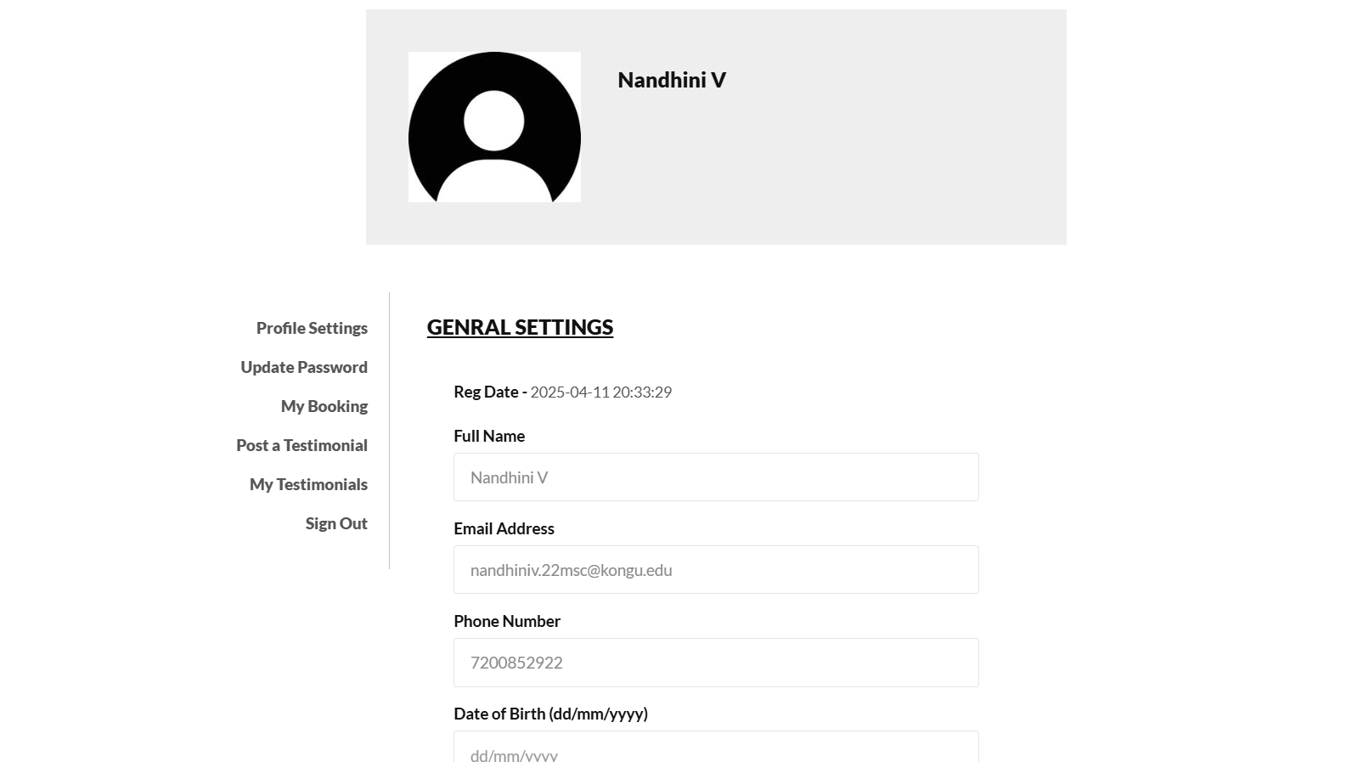

Slide 40
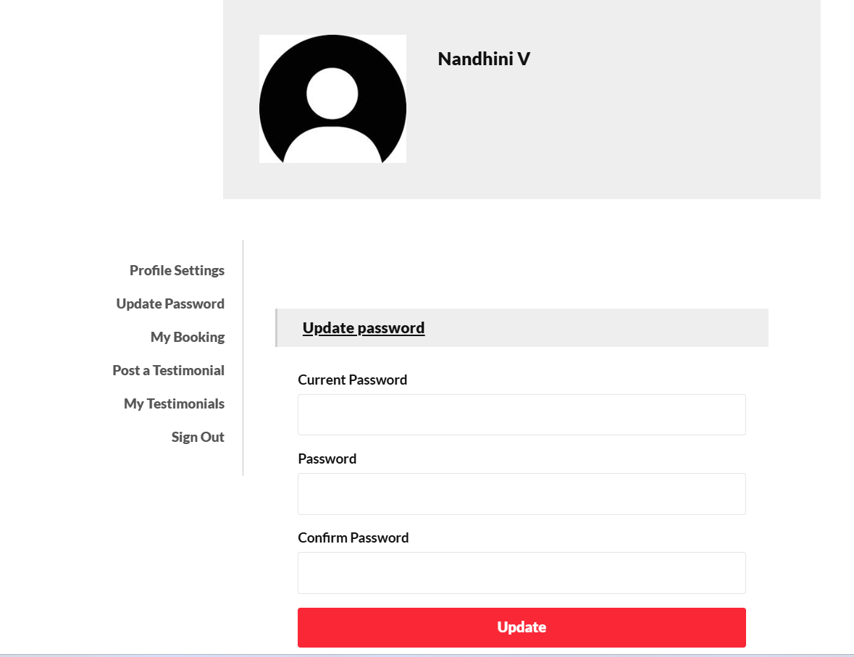

Slide 41
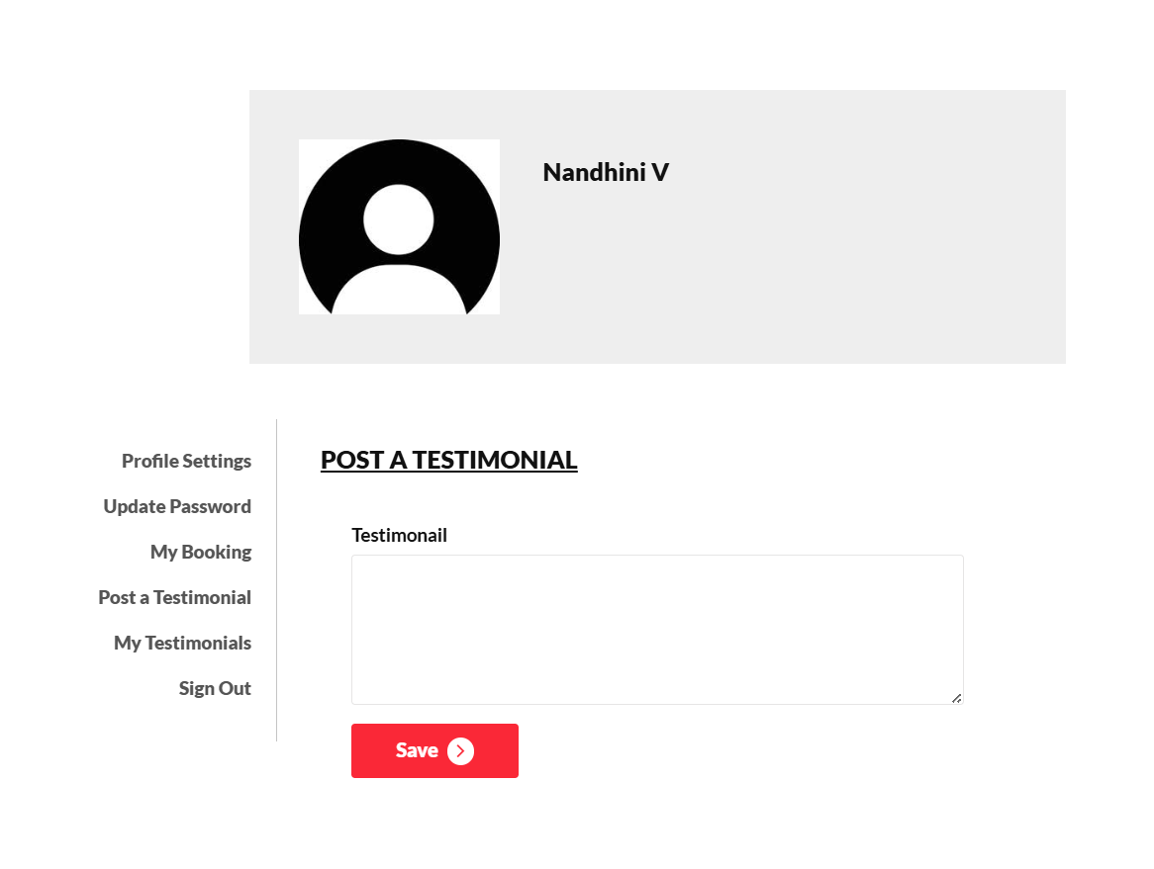

Slide 42
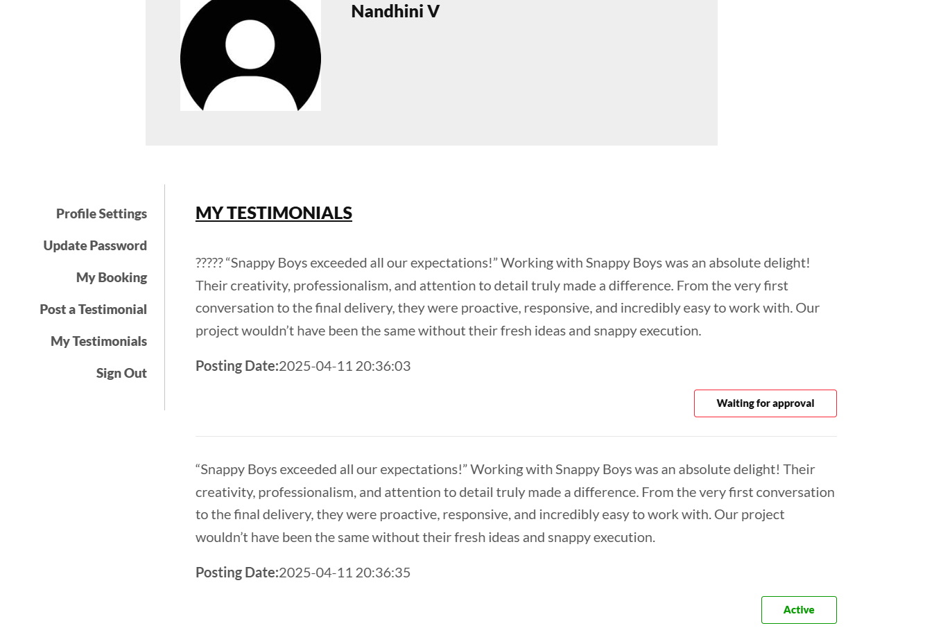

Slide 43
ADMIN PANEL SCREENSHOTS

Slide 44
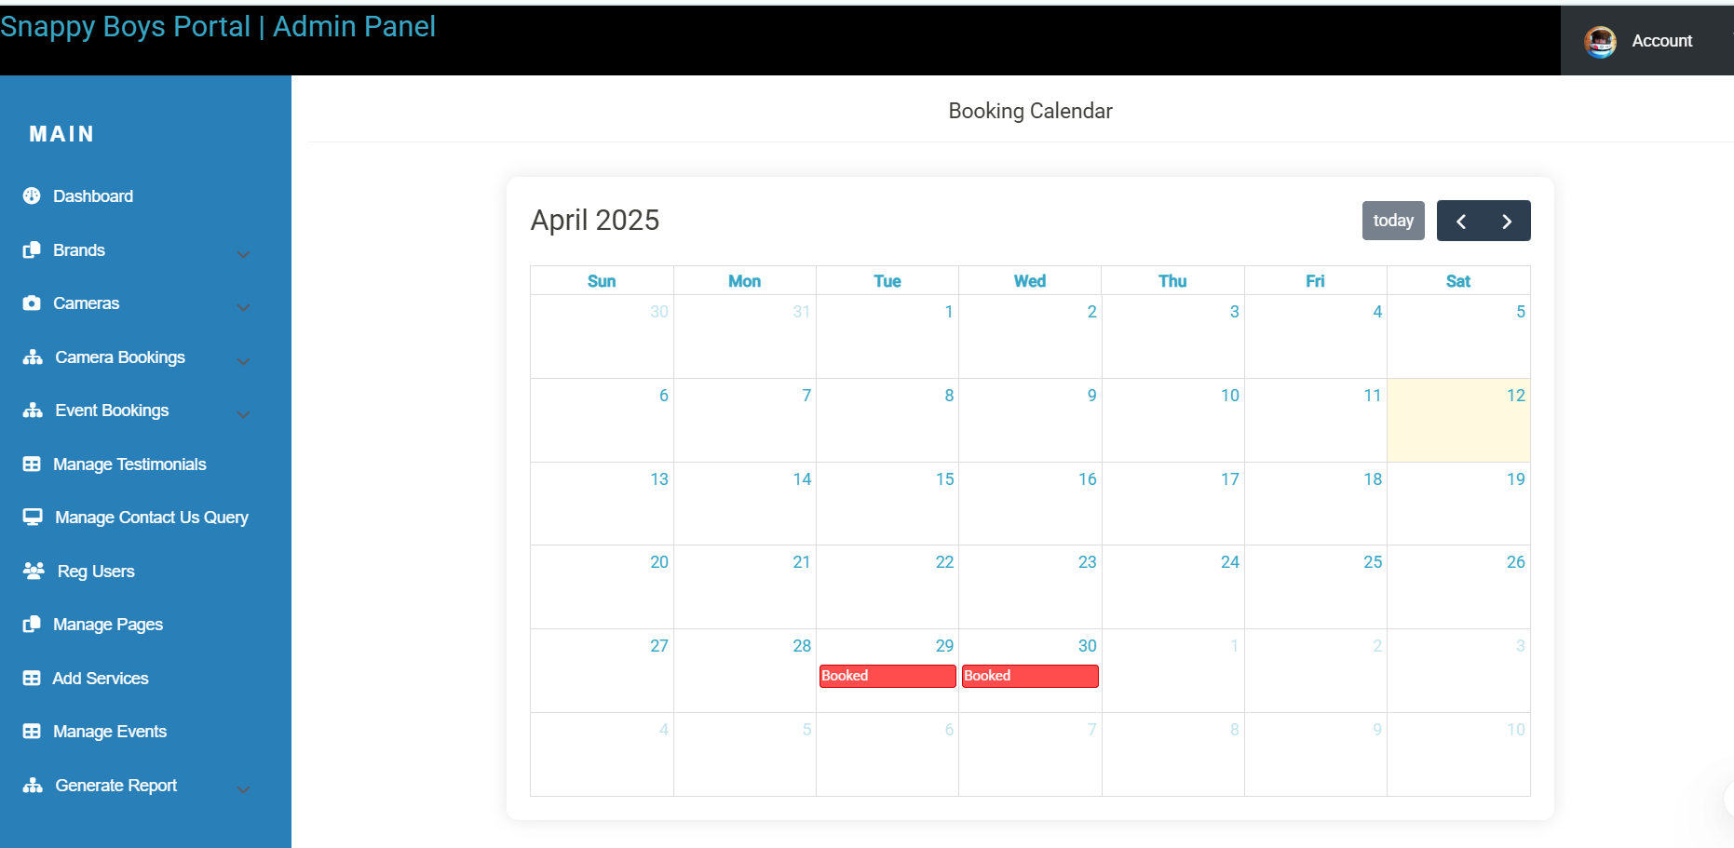

Slide 45
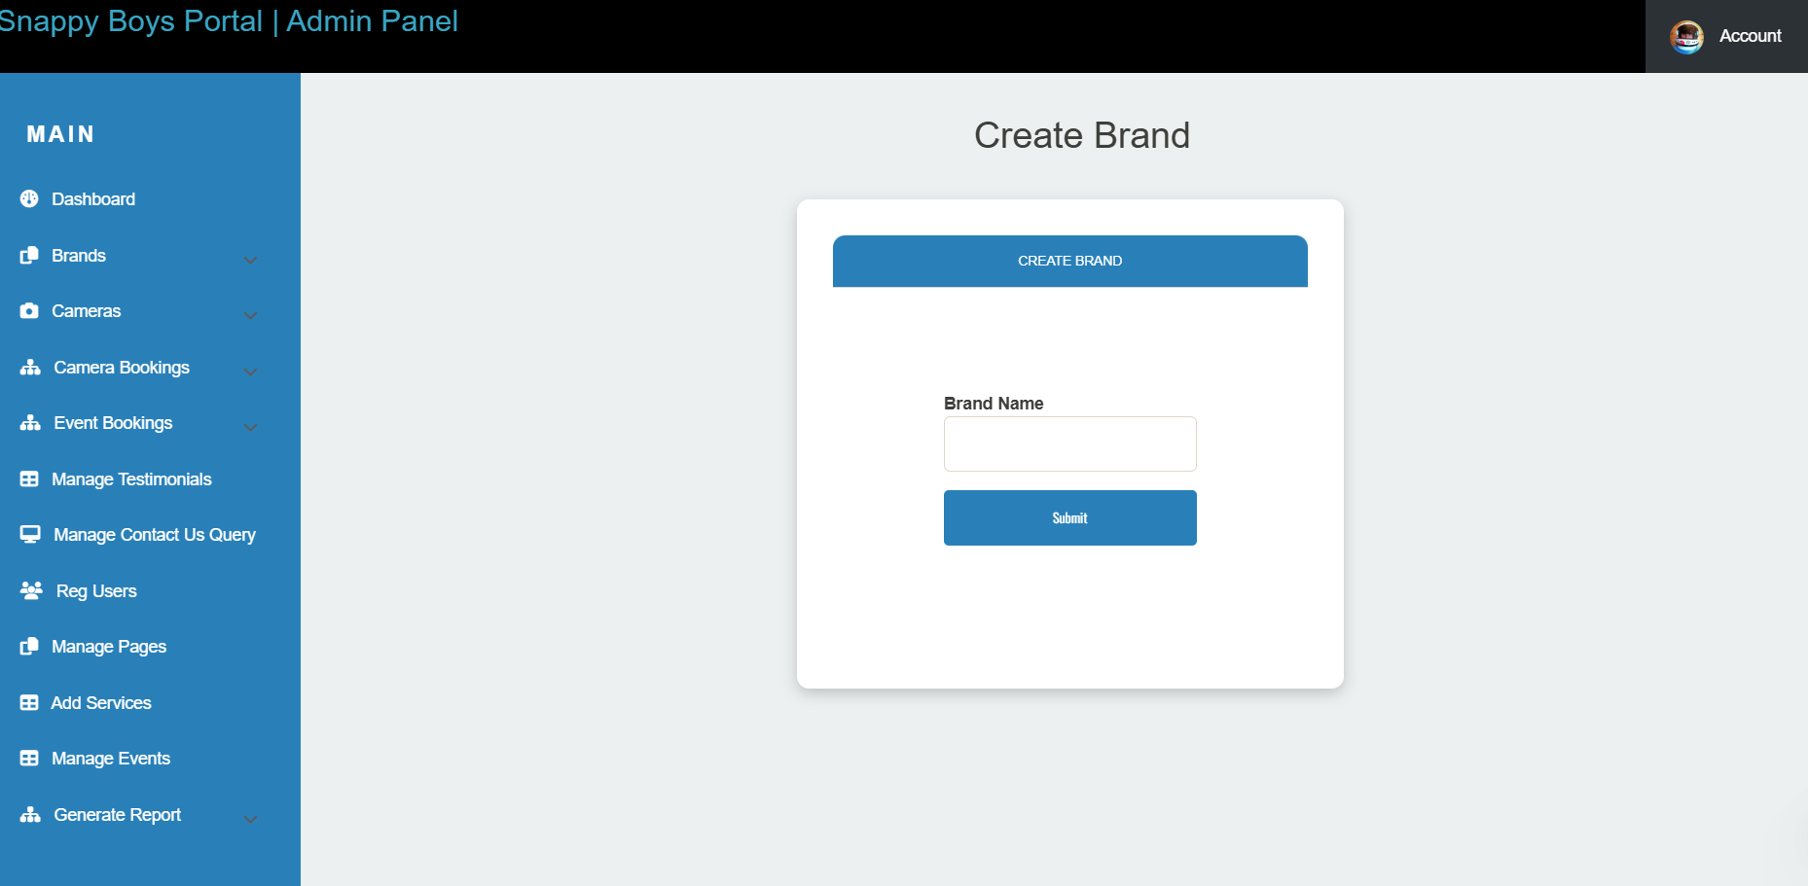
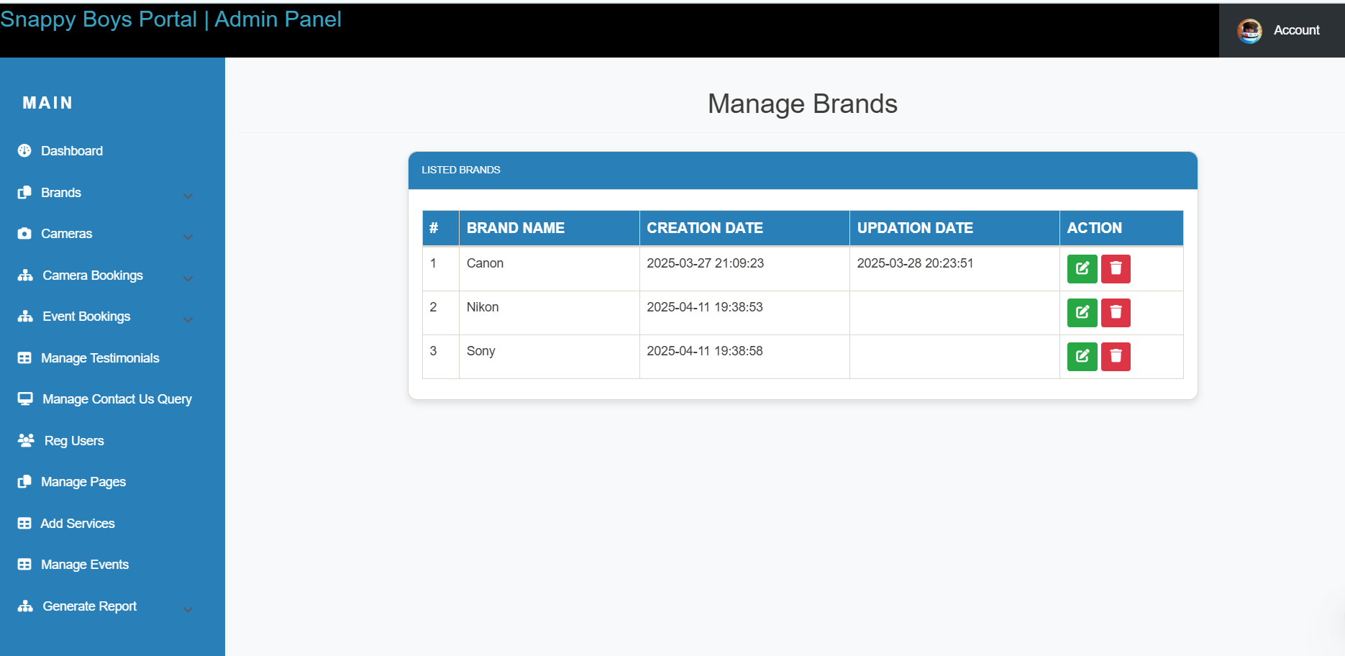

Slide 46
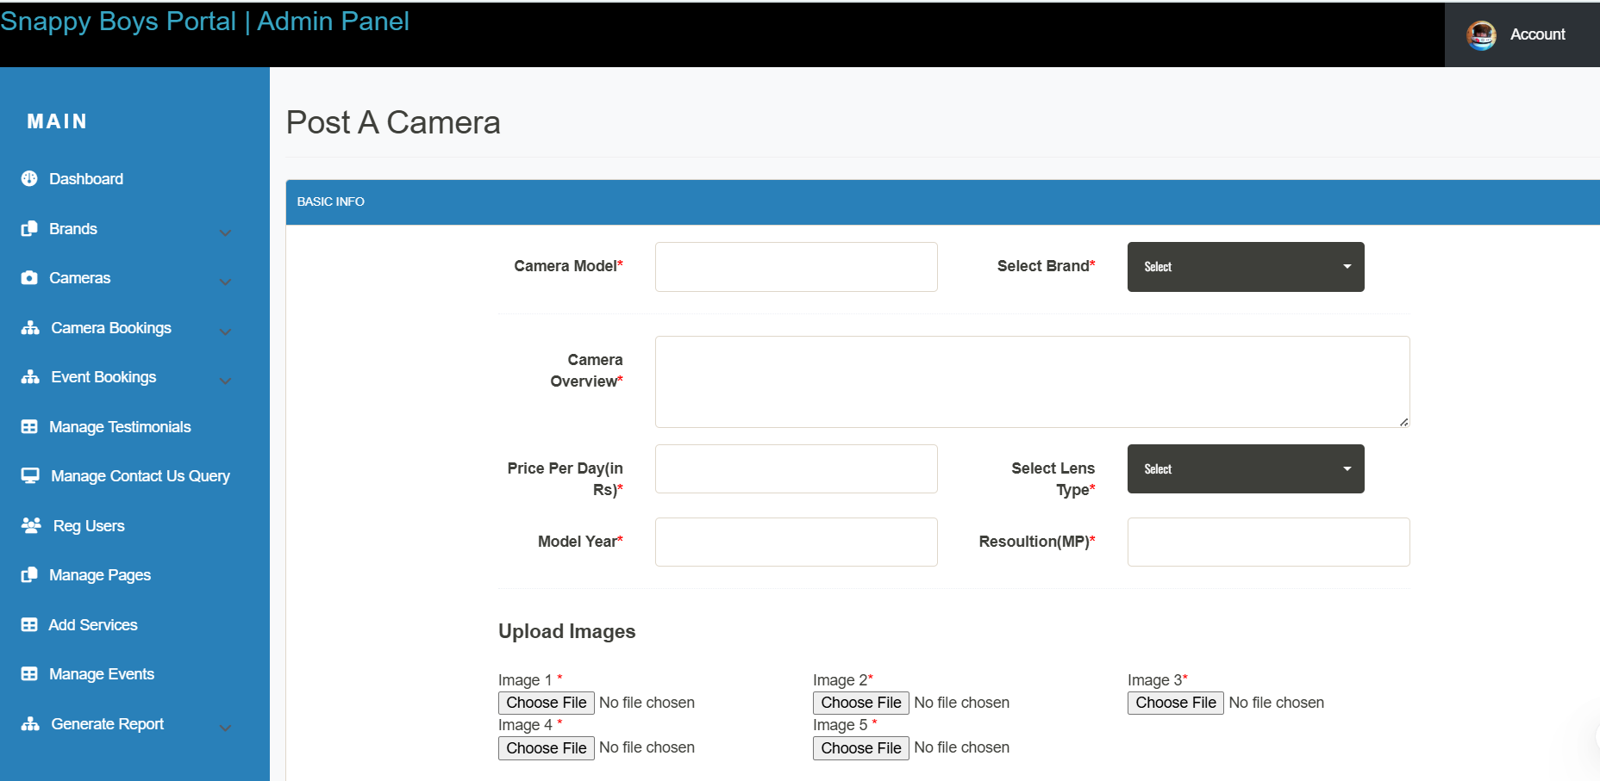
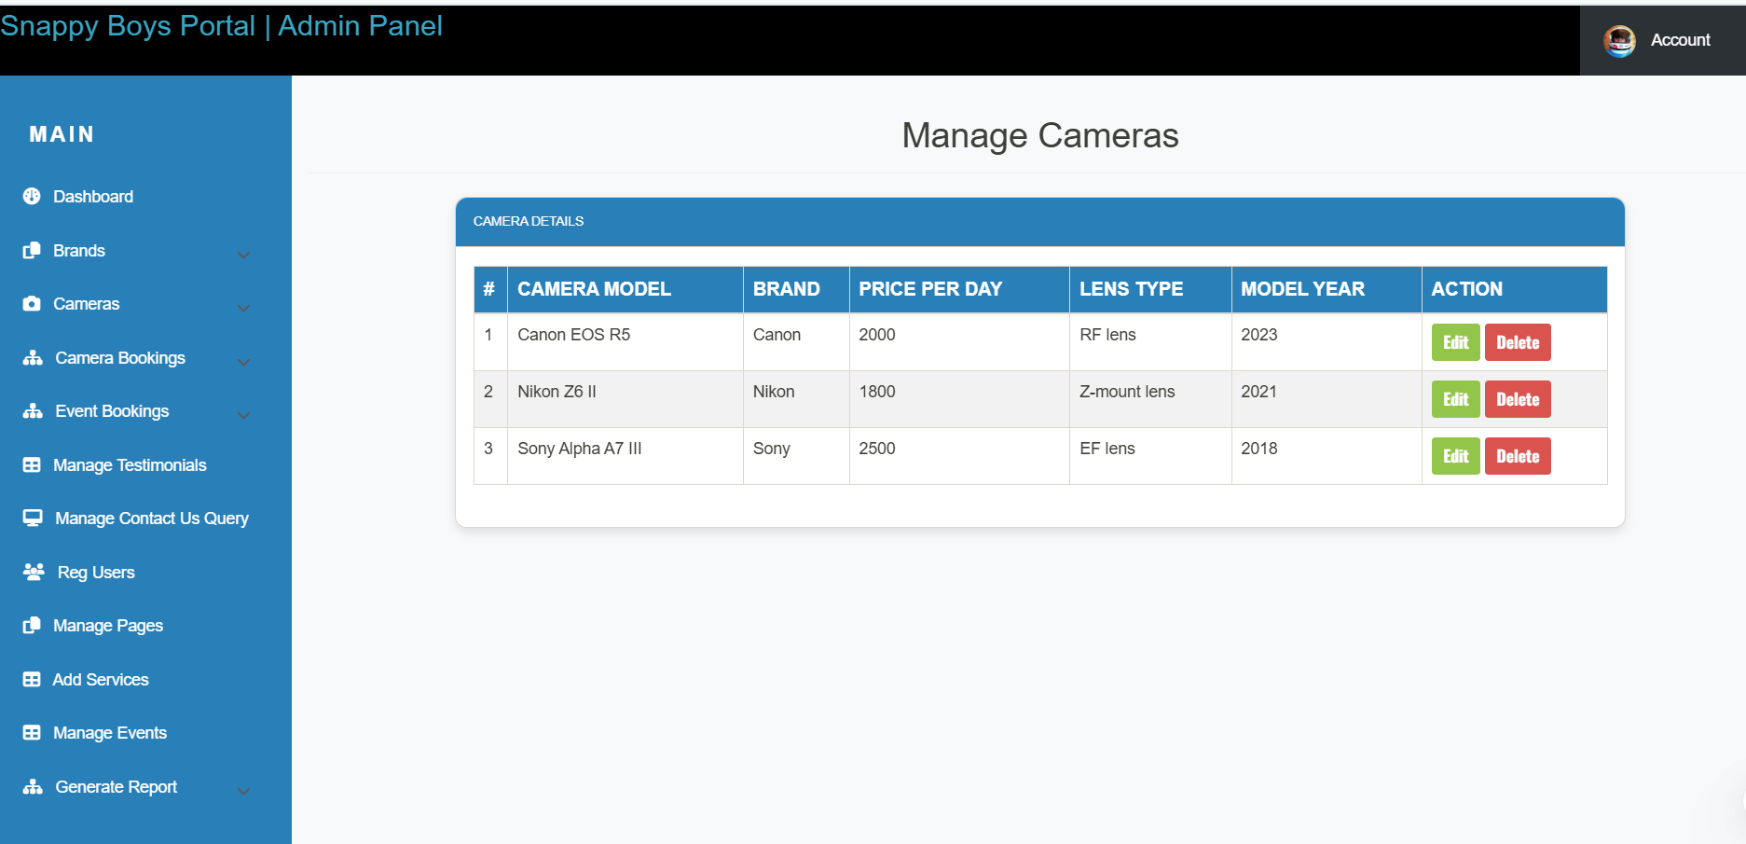

Slide 47
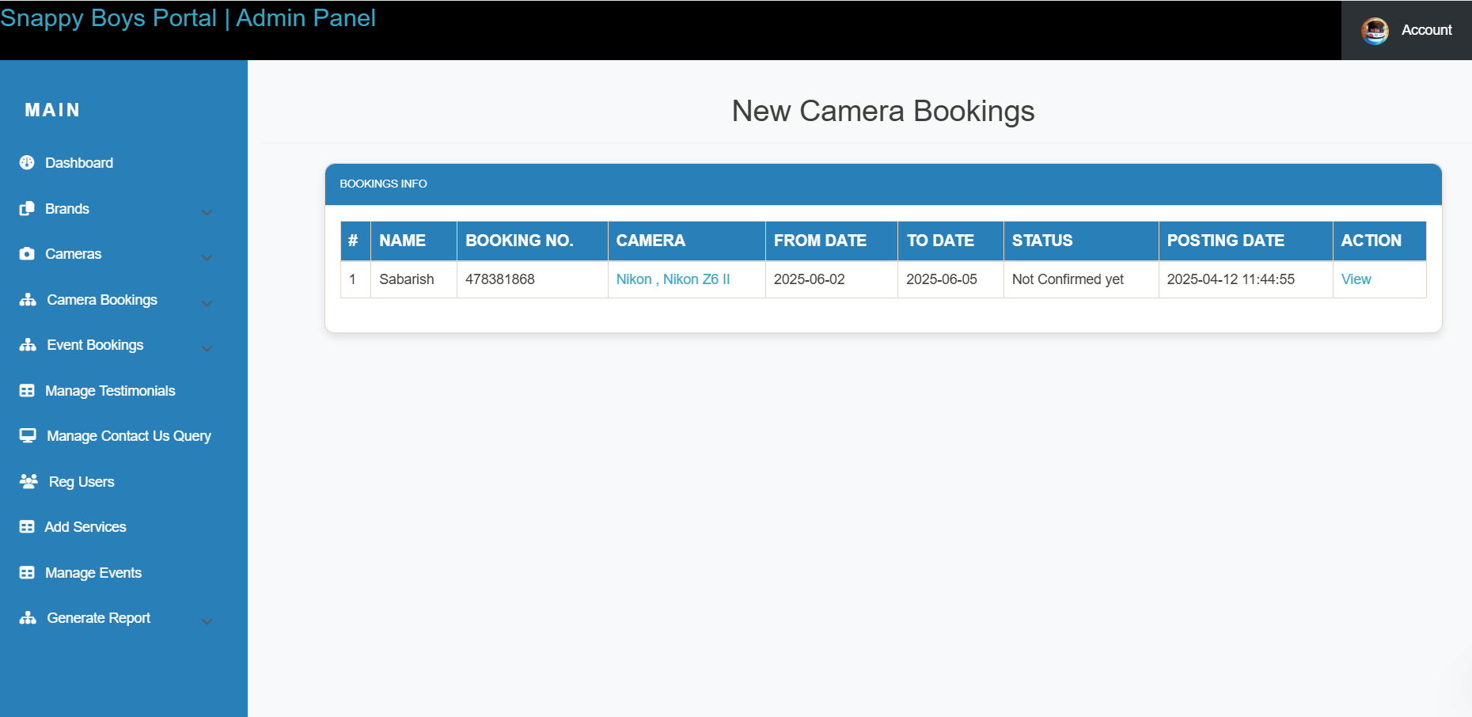

Slide 48
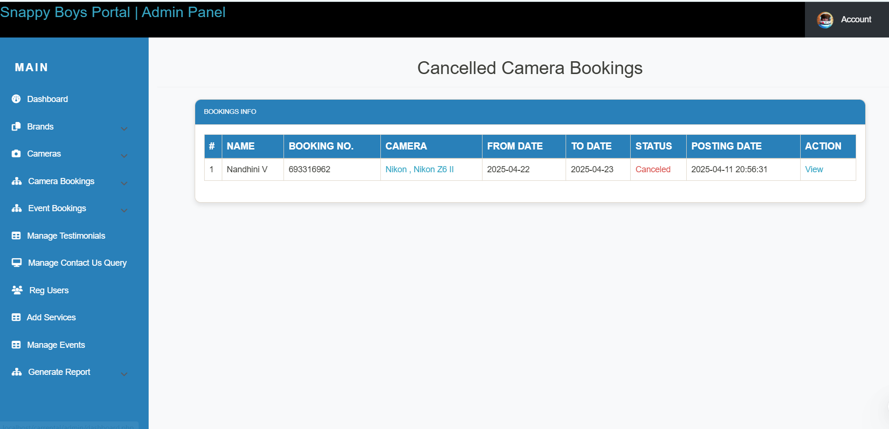


Slide 49
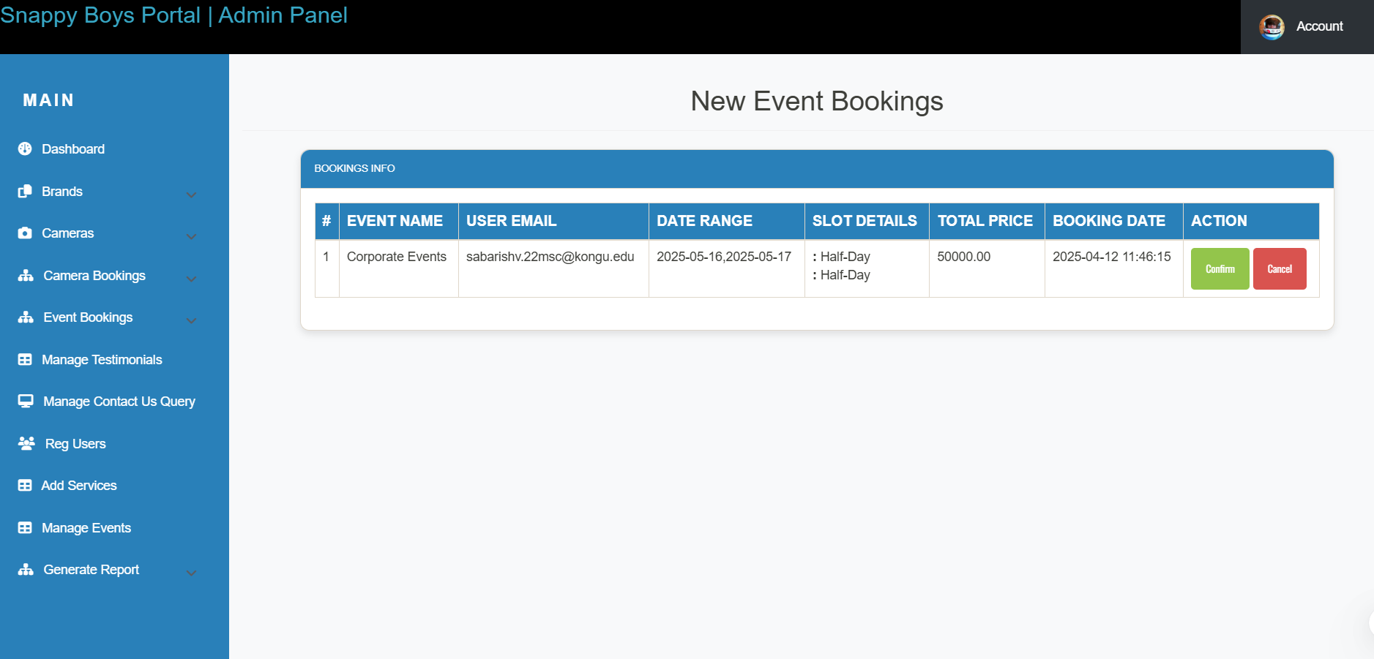

Slide 50
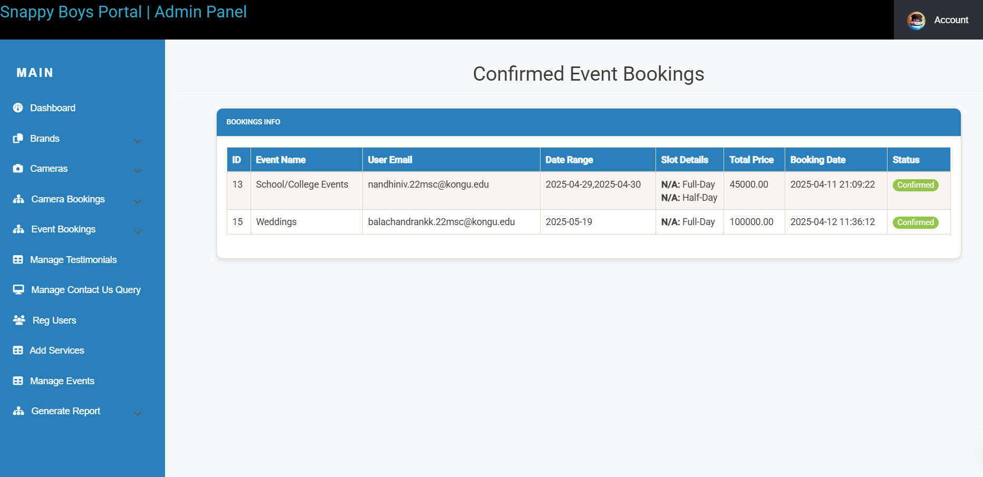


Slide 51
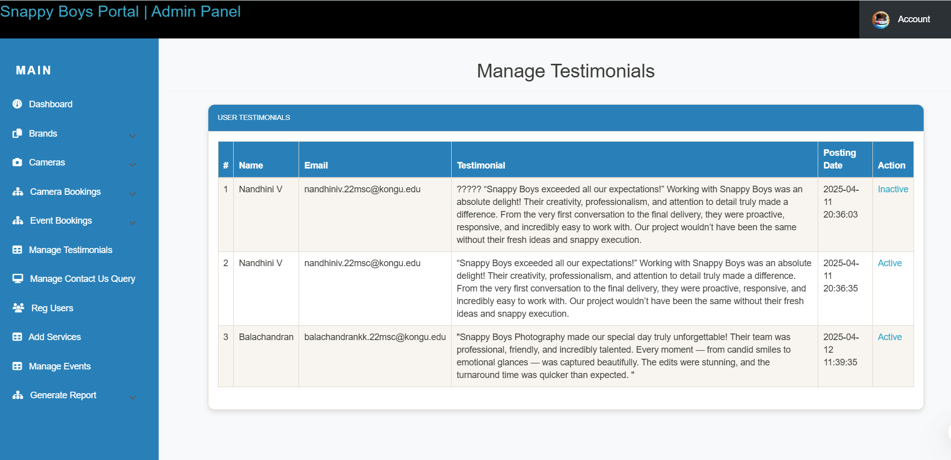

Slide 52
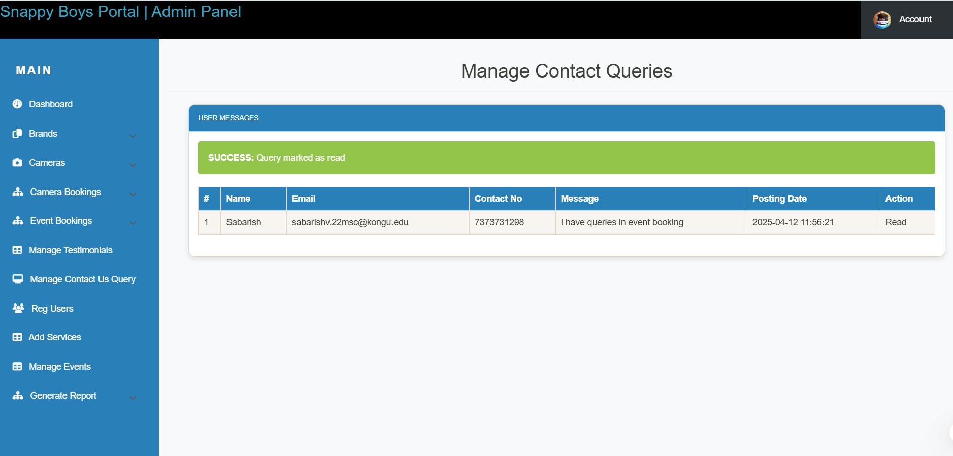

Slide 53
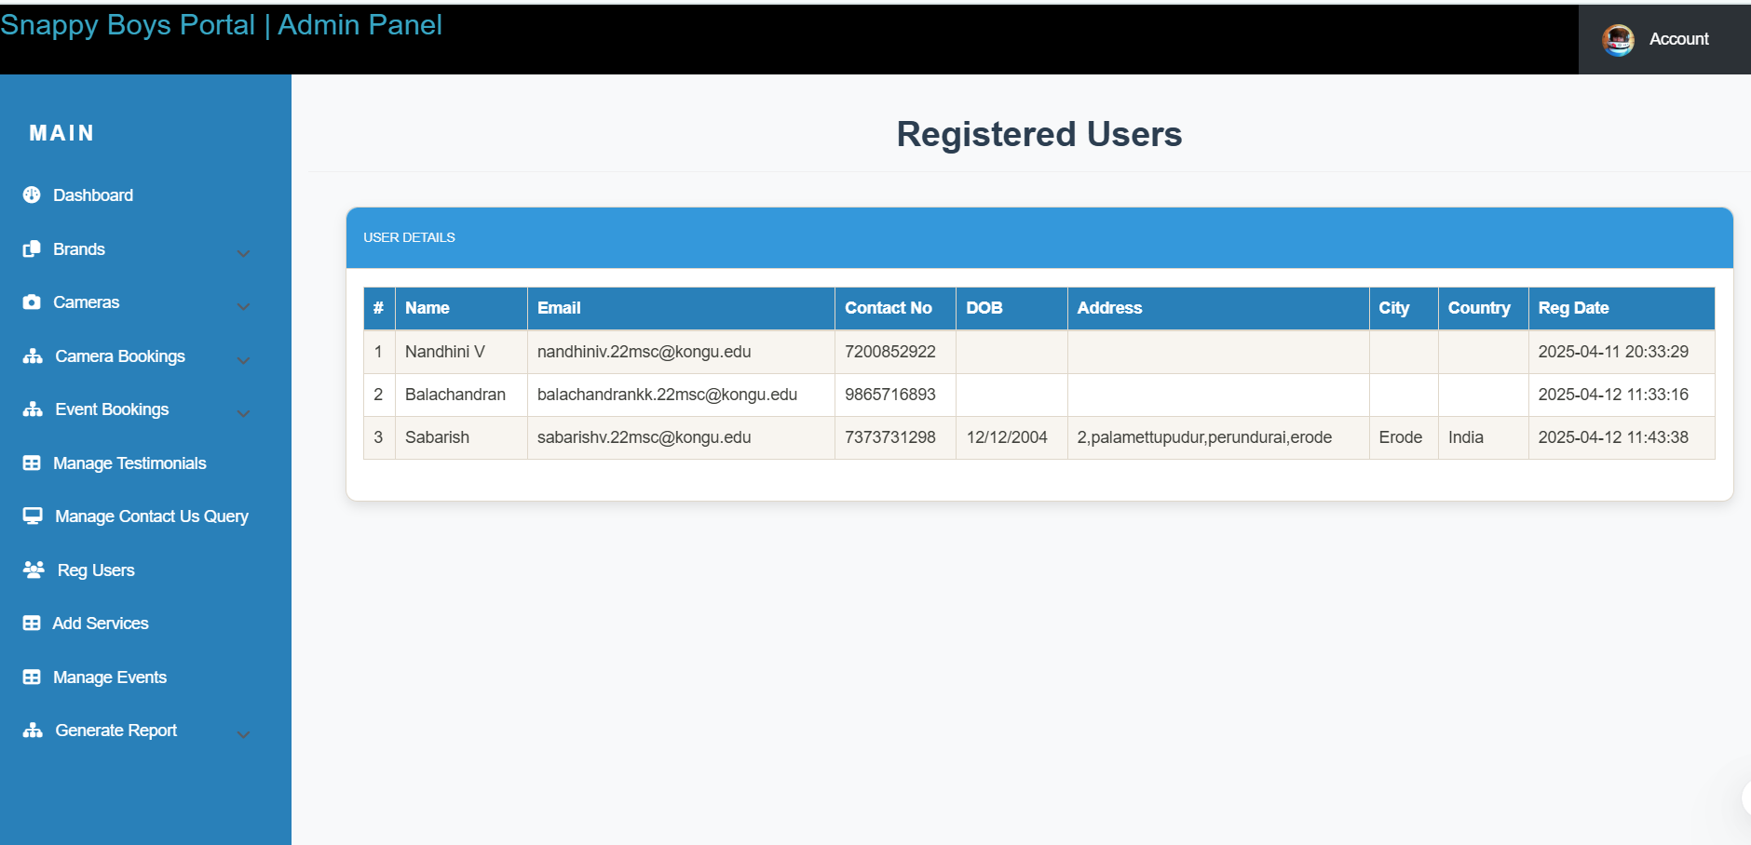

Slide 54
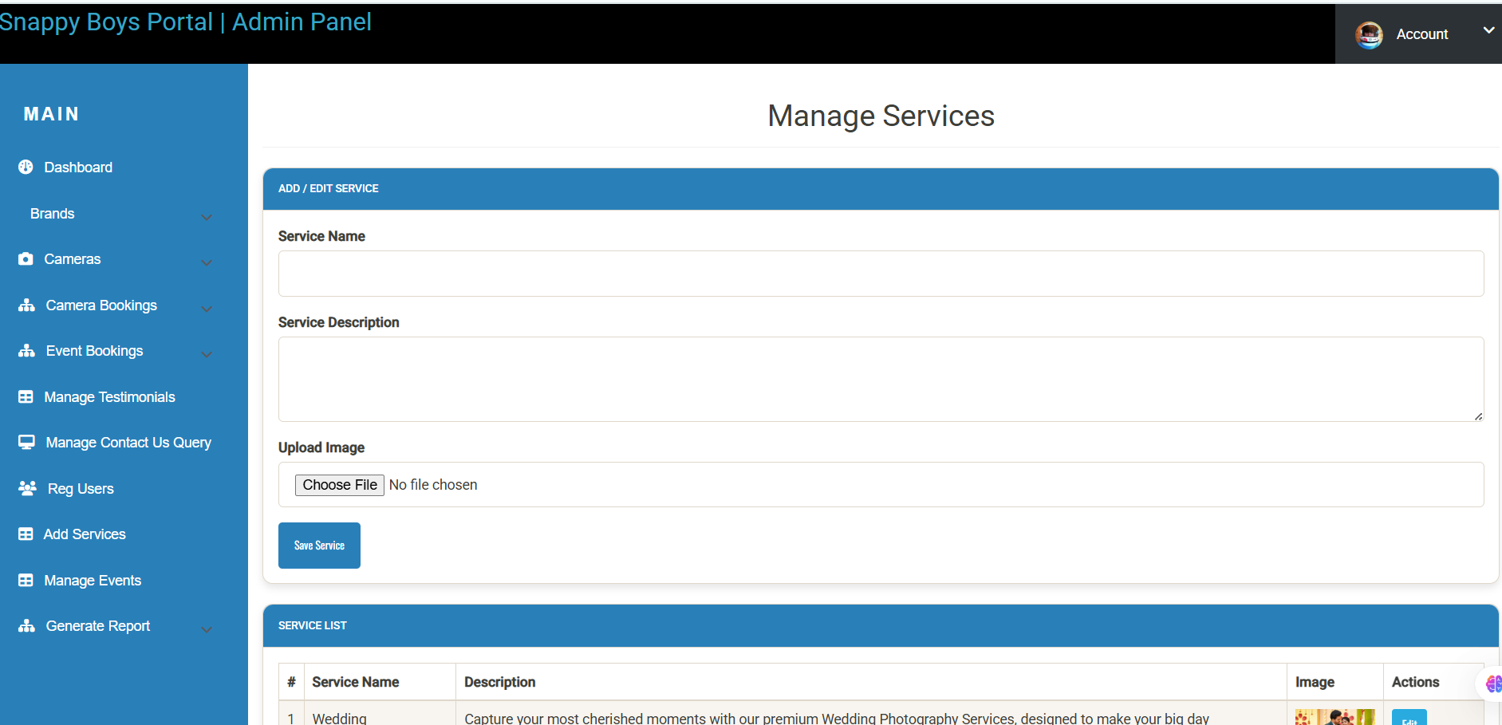

Slide 55
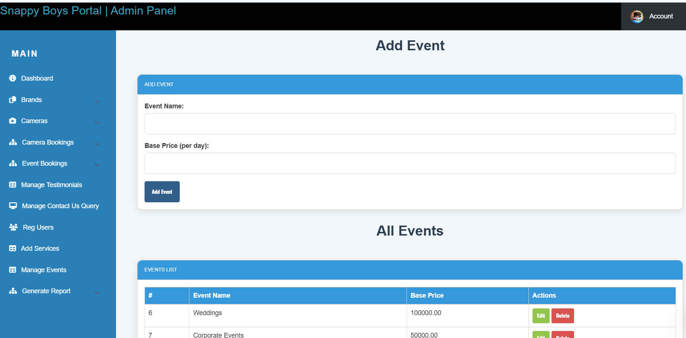

Slide 56
REPORT SCREENSHOTS

Slide 57
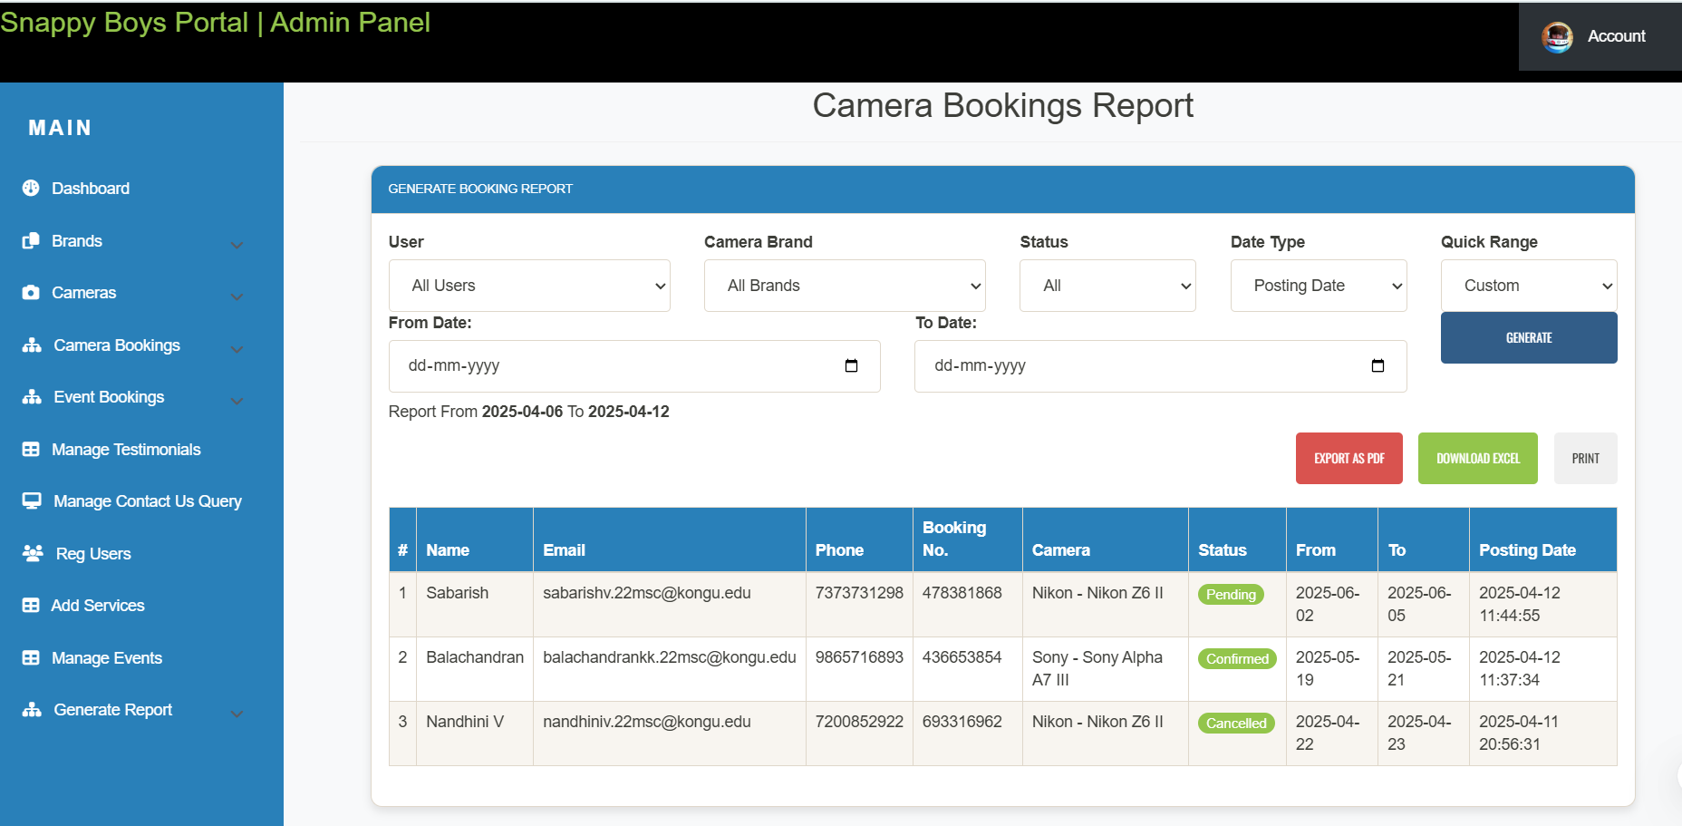

Slide 58
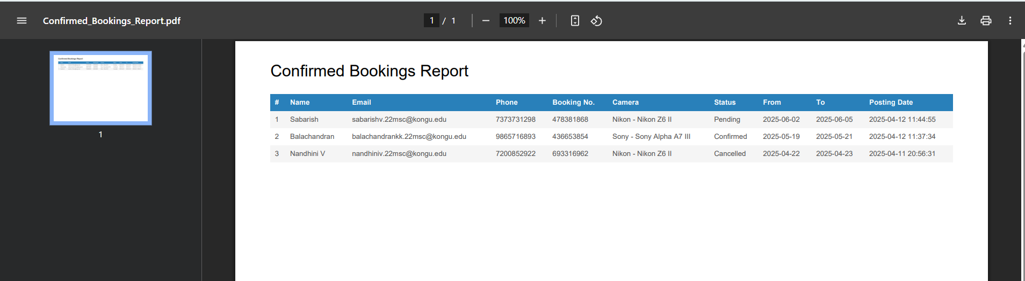
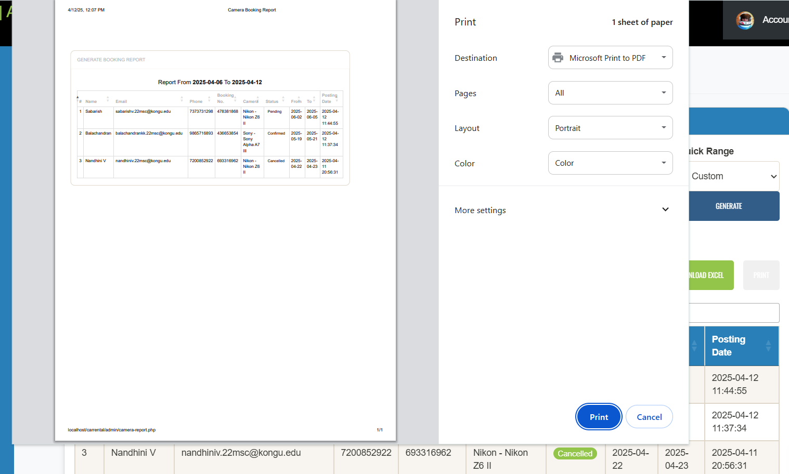
PDF
PRINT

Slide 59
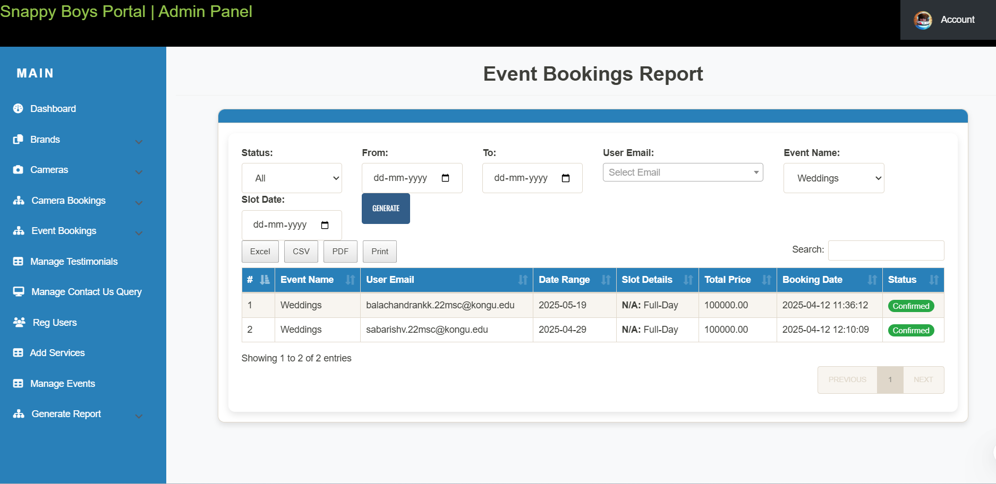

Slide 60
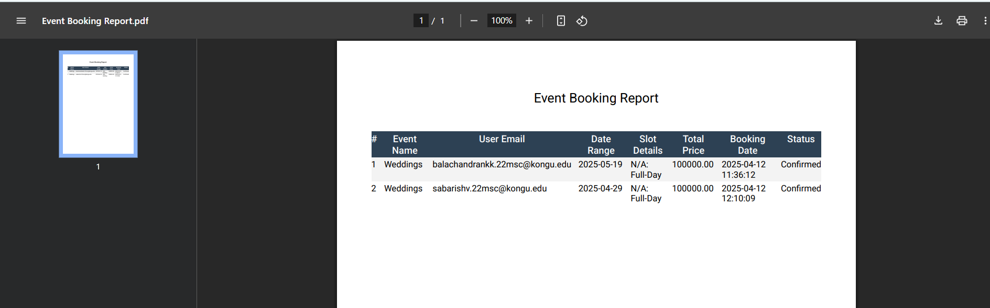
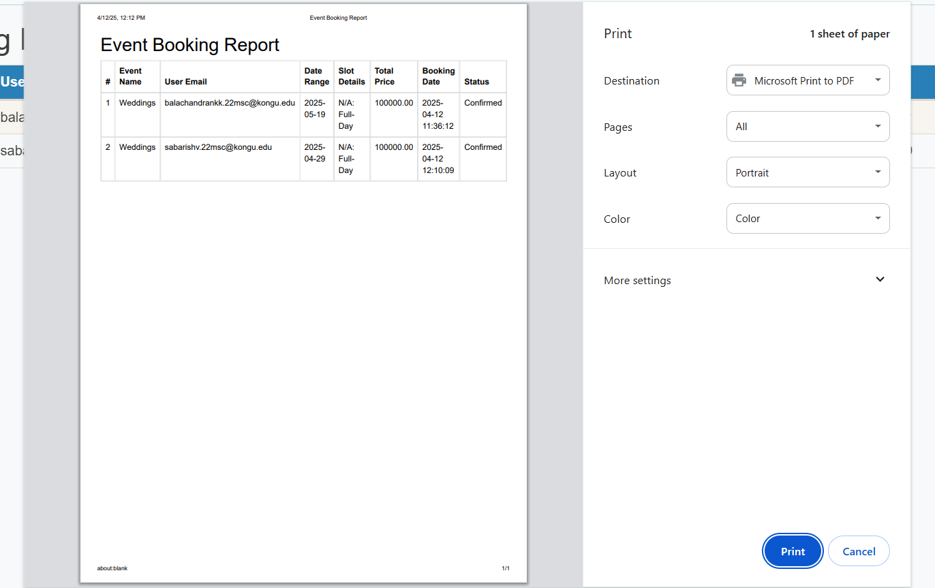
PDF
PRINT

Slide 61
Thank You !!

